Slide 1
Increasing Quality of Science Research Projects
Jenn Cotton

Slide 2
From Passion to Project

Slide 3
Increasing Quality of Science Research Projects

Slide 4
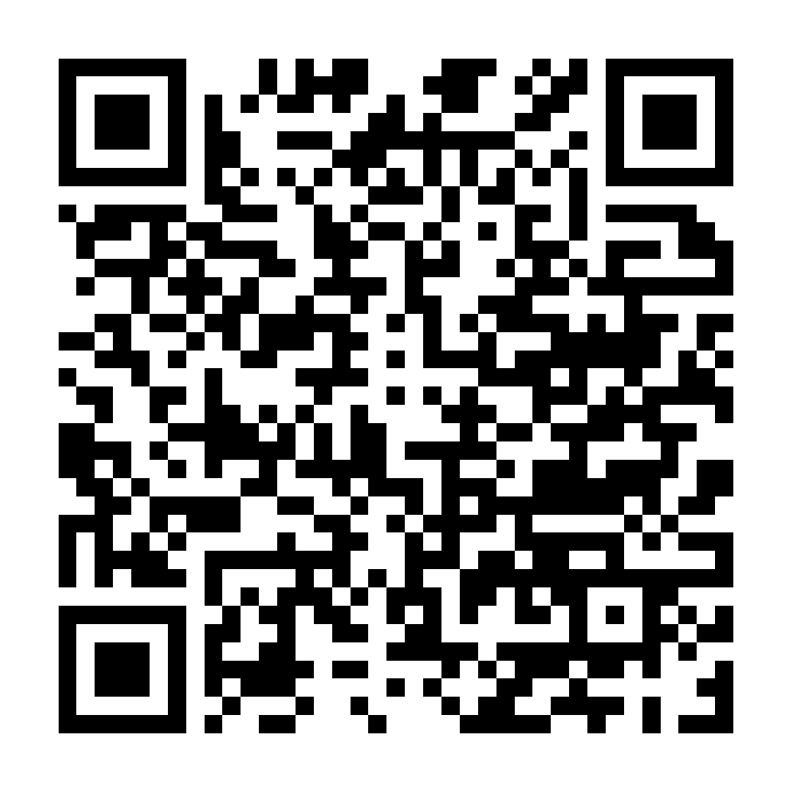
Project Quality Concerns

Slide 6
Let’s ask some questions!
Use Page 2 of the brainstorm sheet and fill in just the questions you have about this topic.

Slide 7
PADLET COLLABORATION
SCAN THE QR CODE.
ADD YOUR TOP QUESTION TO THIS PADLET.

Slide 8
SCIENTIFIC LITERACY
What can you gain from articles related to your research question?
Background information, context, or justification for your project
Methodology
Describing the implications of your results
Can use both simple search engine and academic searches
Complete the rest of Page 2

Slide 9
PADLET COLLABORATION
SCAN THE QR CODE.
Revisit your original question and add a refined question to the comments of your post.

Slide 10
Project Quality Concerns
Reflection

Slide 11
Question asking in your Research Students & Teachers
How could you use the question asking protocol in your research students?

Slide 12
THANK YOU
JENN COTTON
jenn@headwatersscienceinstitute.org
321-591-1146
www.headwatersscienceinstitute.org

