Slide 1




WELCOME

Slide 2



Slide 3


Slide 4
Florida Foundation for Future Scientists, Inc.
is proud to present
The 69th State Science and Engineering Fair of Florida
STEM Competition
April 2 – 4, 2024
RP Funding Center, Lakeland

Slide 5

INTRODUCTIONS
Notes:
BINGO CARDS
Process – Review Blocks
2nd Year Teachers – Medal of “Honor”
LEADERSHIP!!!! Building Capacity through Leadership and Involvement

Slide 6

INTRODUCTIONS
FFFS BOARD OF DIRECTORS
SSEF SRC/D&S Steering Committee
D & S Committee
Awards/Scholarships Committee
Affiliated Fair Directors/Committees

Slide 7

A - Z
Notes:
Introduce Maggie
Chart Paper
Process – Lots of Parts & Pieces to Science Fair

Slide 8
A-Z of an AfFilliated Science Fair
Write AFFILIATED SCIENCE FAIR at the top
A – M down left side
N – Z down right side
A N
B O
C P

Slide 9
Roles on your Team
Scribe: recorder
Supervisor: oversees the group
Specialists: help come up with good ideas!
Spy: will be allowed to spy in round 2

Slide 10
ROUND 1: 2 MINUTES
Think of as many words that have to do with science research/science fair that begin with letters A-Z.
The scribe should be the recorder.
After time is up, proceed to round 2.

Slide 11
ROUND 2 – NO writing
Time: 1:30
For 30 seconds the SPY will go around and look at other answers.
Then they will have a minute to report back to their group to record any words for missing letters.

Slide 12
ROUND 3 – 1 MINUTE
Pass your paper to next group.
On the paper you received you will now attempt to classify the other group’s terms in some way.
Don’t say what the classifications are, just mark them in some way (* for --- or smiley faces for each…)

Slide 13
ROUND 4 – 1 MINUTE
Pass poster back to original group
Figure out what the “categories” are
Check for agreement

Slide 14
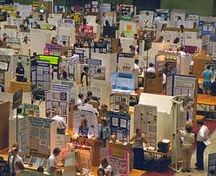
DEFINING MY
AFFILIATED FAIR

Slide 15
Best Practices for the
Management of Affiliated
Science Fairs
SSEF Affiliation Agreement
ISEF Standards for Affiliated Science Fairs
ISEF Affiliation Agreement

Slide 16
STANDARDS for
Affiliated Science Fairs
Society for Science - ISEF
Standards for Science Fairs describe how the most well-managed and responsibly-governed science fairs should, and do, operate.
They provide benchmarks to determine how well a fair is fulfilling its obligations to those who benefit from its work.
They provide core concepts and recommended policies from which a science fair will benefit.

Slide 17
STANDARDS for
Affiliated Science Fairs
Society for Science - ISEF
Standards for Science Fairs serve several important functions.
Most important, they serve as a mechanism to improve individual fairs, thereby raising standards for science fair competitions.
The purpose of the Standards is NOT to make all science fairs look alike.
We respect the individual nature, character and traditions of each science fair.
The diversity of our fairs in the audiences they reach, the territories they cover, and their management and organizational structure enriches the global network of science fairs.

Slide 18
Affiliated RSEF Information
What is the complete name of your RSEF?
Does your RSEF have a logo? Website? Any other icons for recognition?
Approximately how many middle schools are involved? High schools?
How many middle school students participate in your RSEF? High school students?
What is the mission for your RSEF?

Slide 19
How is your RSEF governed??
District?
Foundation/non profit?
University/College
Local Organization? (Kiwanis, Rotary)
Individual
Other? Or combination of?

Slide 20
What are the operational expenses for your RSEF?
Affiliation Fees
Facilities/Venues
Supplies
Stipends
Workshops/Meetings
Awards
Hospitality
Travel – SSEF - ISEF
Other

Slide 21

What are the sources for your funds?

Slide 22
FUNDING
Affiliation Fees
Personnel/Stipends
Venues
Travel
Awards

Slide 23

What written policies & procedures are in place?

Slide 24
RSEF Policies & Procedures
Do you have written policies and procedures?
Eligibility
SRC and IRB
Judging
Awards

Slide 25


What Are Your Committees?
Describe the function(s) of your RSEF committees.
What is the make up of the committees…teachers, district, community members from….etc.?
OR

Slide 26
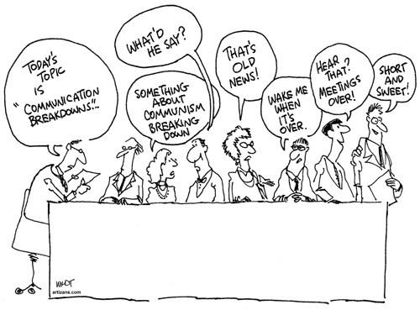
How does your RSEF communicate with stakeholders to promote the RSEF and provide information?

Slide 27
What are the expectations and responsibilities for an affiliated RSEF Director?
RSEF Director

Slide 28
RSEF Director
EXPECTATIONS
Ensures proper management of the science fair
Ensures that all fair programs and activities are adequately and appropriately planned, supervised, resourced, and staffed with qualified personnel/volunteers
Undertakes long range and strategic planning to accomplish the fair’s mission and goals
Maintains appropriate relations with fair’s staff, volunteers, members of the community of stakeholders – schools, school system, teachers, students, parents, etc.
Maintains documentation of all the operational
processes of the fair
…………and

Slide 29


Slide 30
SSEF AFFILIATION REQUIREMENTS

Slide 31

RSEF PROJECT QUOTAS
The Affiliated RSEF is allocated a specific number (quota) of PROJECTS. Affiliation FEES will be determined by this quota.
Individual Finalist entries will be $100 each
$200 for each 2-Member Team Project.
$300 for each 3-Member Team
An INVOICE will be provided upon signing the Affiliation Agreement
AFFILIATION FEES are DUE by NOVEMBER 15th
If extra Teams/Team members are entered during February instead of individual projects, an extra charge of $100 will be invoiced for each additional student participant entered above funds already submitted
NO RSEF CAN EXCEED QUOTA FOR TOTAL # OF PROJECTS ENTERED INTO THE SSEF
Notes:
Talk about Invoicing
Quota Chart

Slide 32
Affiliation Guidelines
The RSEF must serve a geographic territory that is not covered by another affiliate fair.
The SSEF is open to all students in grades 6th – 12th. Public, non-public, and home school students are eligible to participate in both the SSEF and the RSEF that incorporates their geographic location.
The RSEF Director must notify and invite the participation of all public and Florida Department of Education – registered non-public schools.
Be aware that to enter the State Science & Engineering Fair of Florida or or ISEF, students must first compete at a local or regional fair.

Slide 33
Eligibility for SSEF of Florida
A student must be selected by the RSEF of Florida affiliated fair.
Students may compete in only one SSEF affiliated fair.
Each student is only allowed to enter one project. That project may include NO MORE than 12 months of continuous research and may NOT INCLUDE research performed before January 2023.
Team projects must have no more than three members.
Only APPROVED projects by the SSEF of Florida Scientific Review Committee (SRC) may be entered into the SSEF of Florida.

Slide 34
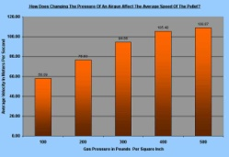
    RSEF FINAL REPORT/SUMMARY due with entries and NO LATER than March SRC.
Used to compile data required for funding and grants
Available for Affiliated RSEF to use

Slide 35
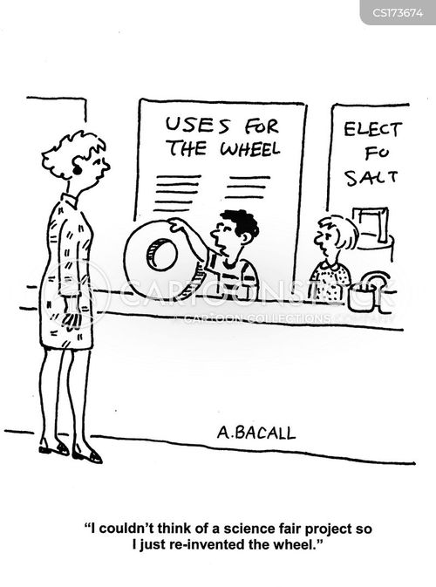
INCREASING THE
QUALITY OF
SCIENCE RESEARCH PROJECTS
Jennifer Cotton
Headwaters Science institute

Slide 36


Slide 37
The Experience of
Conducting STEM Research
Setting GOALS to work toward
TIMELINES to guide work
Substantial INCENTIVES for innovative and thorough research projects
Test drive STEM Career fields
Gain real STEM skills and applied knowledge
Sharpen analytical thinking skills, planning, communication
Make CONNECTIONS with STEM professionals and future professionals

Slide 38
Student Motivation
Reasons to do Science Research
Part of rigorous curriculum/culture for learning
Involved in ethical research
Problem solving/critical thinking
Hands-on/authentic/Application of real-world problem solving
Awards/Scholarships
Trips/Opportunities
Career development
College resume / perseverance; involvement; passion
Building skills – science/engineering/communication
Community service
Competition
Showcase school/district
Personal success/feelings of accomplishment
Connecting with professionals/mentors/judging interviews
Travel; Fun; memorable experiences

Slide 39

Region Sharing
ACTION PLAN
Brainstorm and record ways you provide motivation & resources for increasing the quality of student science research
Notes:
Post on Wall and review during Break!

Slide 40

Growing Your
Research Program
Increasing participation in science research programs
Will Furiosi – Oviedo Science Research, Seminole
Ryan Cilsick – Brevard Intracoastal – Edgewater HS
Jenn Davis – Palm Beach RSEF

Slide 41
INCREASING SCHOOL INVOLVEMENT
Number of Schools in SSEF DATA - 2023
Middle 127 Public
31 Private
High School 102 Public
22 Private
1 Home School – Middle School

Slide 42

MAKING CONNECTIONS
UFCALS – Charlotte Emerson
DataClassroom – Aaron Reedy
Kelly Cranford – Florida Engineering Society

Slide 43

DataClassroom

Slide 44


Slide 45
LIYSF
London International Youth Science Forum
Full scholarship to attend the London International Youth Science Forum, and a $1,500 cash stipend for travel expenses.
TMED079 — Analyzing the Effects of Turmeric & Curcumin on Tau Aggregation & Amyloid Beta Plaques on Caenorhabditis elegans and Its Further Implications Into Alzheimer’s Disease
Aayushi Ranjan, American Heritage School of Boca Delray, Boca Raton, FL, United States of America
Students will receive a fully funded place to attend the London International Youth Science Forum this, held late July to early August. The award covers the costs in London and includes the full LIYSF program for 15-days, meals and accommodation throughout. A travel stipend is awarded to ensure the awarded winning student is able to get to London from their home and back, at no cost to them.
https://www.youtube.com/watch?v=_RfJ_yLTQHA&t=4s

Slide 46


Slide 47
Purpose of Rules for
Science Research Competitions
Protect the rights and welfare of the student researcher
Protect the rights and welfare of human participants/subjects
Protect the health and welfare of vertebrate animals
Protect and promote good stewardship of the environment
Ensure adherence to state (FL) and federal regulations
Ensure use of safe laboratory practices
Protect the environment
Determine eligibility for competition

Slide 48
Eligibility for SSEF of Florida –
Affiliated Fairs
The Affiliated Fair MUST have an established Scientific Review Committee (SRC) as detailed in the ISEF Rules. https://www.societyforscience.org/isef/international-rules/roles-and-responsibilities-of-students-and-adults/#SRC
The Affiliated Fair adhere to the International Rules for Precollege Science Research: Guidelines for Science and Engineering Fairs (ISEF Rules) and the SSEF of Florida Rules and Guidelines Supplement and students, teachers and parents are informed about these requirements so that they use ISEF forms from the start of research. https://www.societyforscience.org/isef/international-rules/rules-and-guidelines/
The Affiliated Fair is responsible for ensuring finalists selected to attend
the SSEF of Florida meet the eligibility requirements.

Slide 49
SSEF SRC
Steering Committee
Monitor the SSEF SRC Hotline year-round flscifair.src@gmail.com
Pre-Review Sensitive Projects – January and February
Monitor the Spring SRC Review of all projects – March
Approve and Clear Projects for the SSEF prior to on site competition

Slide 50

68th SSEF SRC Steering Committee
Tia Brown
Mark Butler
Jennifer Cotton
Jennifer Davis
William Furiosi
Peter Gay
Karen Johnson
Maggie Molledo
Rachel Novella
Kim Rex (D & S)
Karen Getty Stewart
Dan Thomas (D & S)
Patricia Zalo

Slide 51
SEEKING SSEF SRC MEMBERS
Addition SRC Members needed!
Learn from each other!
Decisions made as a Team!
Welcome New Members
Brandon Anglin
Marna Fox
Greg Goebel

Slide 52
SSEF SRC Summary - 2023
GOAL: to NOT approve projects on site
750 Projects submitted for approval to participate in the 68th SSEF of Florida
223 sensitive projects pre-reviewed during February (2 SRC members/project)
9 Sensitive projects approved
214 Sensitive projects NOT approved
527 Non-sensitive projects reviewed in Orlando
414 approved
266 not qualified (DNF)
58 DNF + Interview required

Slide 53
SRC Summary, continued
Without the above advanced clearance process, 336 students would have started their SSEF experience with an on-site interview and paper clearance
SSEF SRC Steering Committee interviewed 52 students in advance (virtual) over a two-week window
SSEF SRC Steering Committee (for sensitive projects) plus new volunteers (for non sensitive projects) verified and approved 229 projects prior to the SSEF
Only 60 projects were reviewed on-site (8 interviews and 52 DNFs)

Slide 54
The Affiliated Fair is responsible for ensuring finalists selected to attend
the SSEF of Florida meet the eligibility requirements.

Slide 55
Affiliated Fair SRC Data
How many total projects submitted to SSEF?
How many were Sensitive Projects? (PHBA, Human, Vertebrate, Continuation, Other)
How many Projects were approved March 10th?
How many Projects were NOT approved March 10th? (DNF)
How many Interviews were required?
Identify strengths and weaknesses.
Identify solutions to improve.

Slide 56
RESEARCH APPROVAL
SSEF SRC STEERING COMMITTEE

Slide 57
Display & Safety
Updates
Danny Thomas, Logistics Chair
Kim Rex, Chairperson

Slide 58

FFFS Board of Directors and Regional Directors Fall Meeting

Slide 59


Slide 60
SC.912.N.1.1
SC.912.N.1.1
Define a science problem and do the following:
• Pose questions about the natural world.
• Conduct systematic observations.
• Review what is known in light of empirical evidence.
• Plan investigations.
• Use tools to gather, analyze, and interpret data.
• Pose answers, explanations, or descriptions of events.
• Generate explanations that describe natural phenomena.
• Use appropriate evidence and reasoning to justify those
explanations to others.
• Communicate results of scientific investigations.
• Evaluate the explanations produced by others.

Slide 61
Participant Reflections on
Science Fair Experiences…Jeffrey I. Seeman
Fair participants……..
feel they are “stretched” academically and personally
recommend “choosing a project that interests you”
recognize that their own curiosity and interests can lead to compelling research questions and substantive scientific hypothesis
believe their research can and will have meaningful consequences
feel they are “living” the scientific process – just as professionals do
feel welcomed and encouraged to interact with professional scientists
feel they are EXPERTS on their topics

Slide 63
Increasing School/Student Participation
GUIDING PRINCIPLE
Encourage students to participate and explore the many methods of scientific research
Big Springs Regional Science & Engineering Fair

Slide 64
STOP

Slide 65

#FloridaSSEF

Slide 66
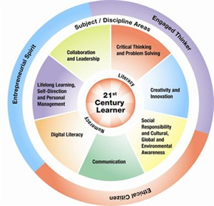

Slide 67



Table Reporting
But…
Who Has Time?

Slide 68
Research Categories
FULL Category Name
Animal Sciences
Behavioral & Social Sciences
Biomedical & Health Sciences
Cellular/ Molecular Biology & Biochemistry
Chemistry
Earth & Environmental Sciences
Engineering
Environmental Engineering
Intelligent Machines, Robotics & Systems Software
Mathematics & Computational Sciences
Microbiology
Physics & Astronomy
Plant Sciences

Slide 69




Slide 70
SHARE HOW YOUR REGION PROVIDES RESOURCES FOR TEACHERS IMPLEMENTING INDEPENDENT SCIENCE RESEARCH

Slide 72

IN MEMORIAM

Slide 73
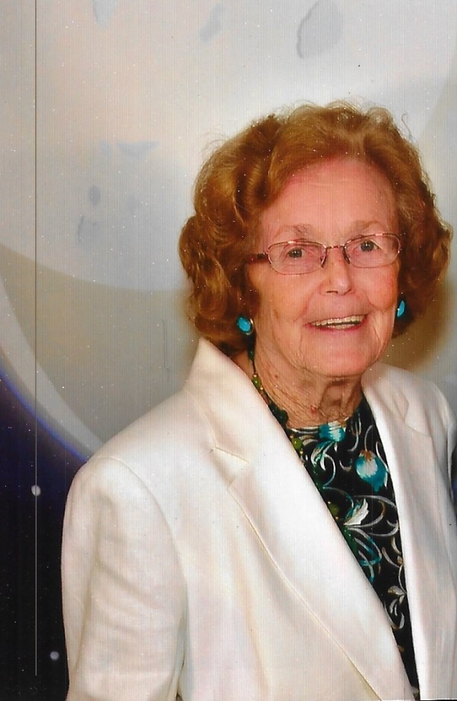
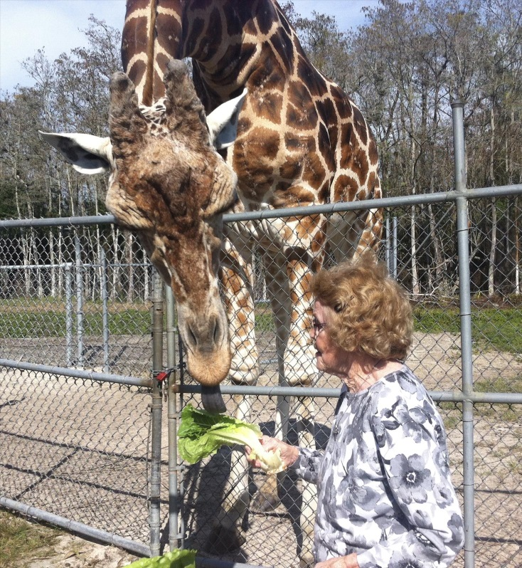
IN MEMORIAM

Slide 74
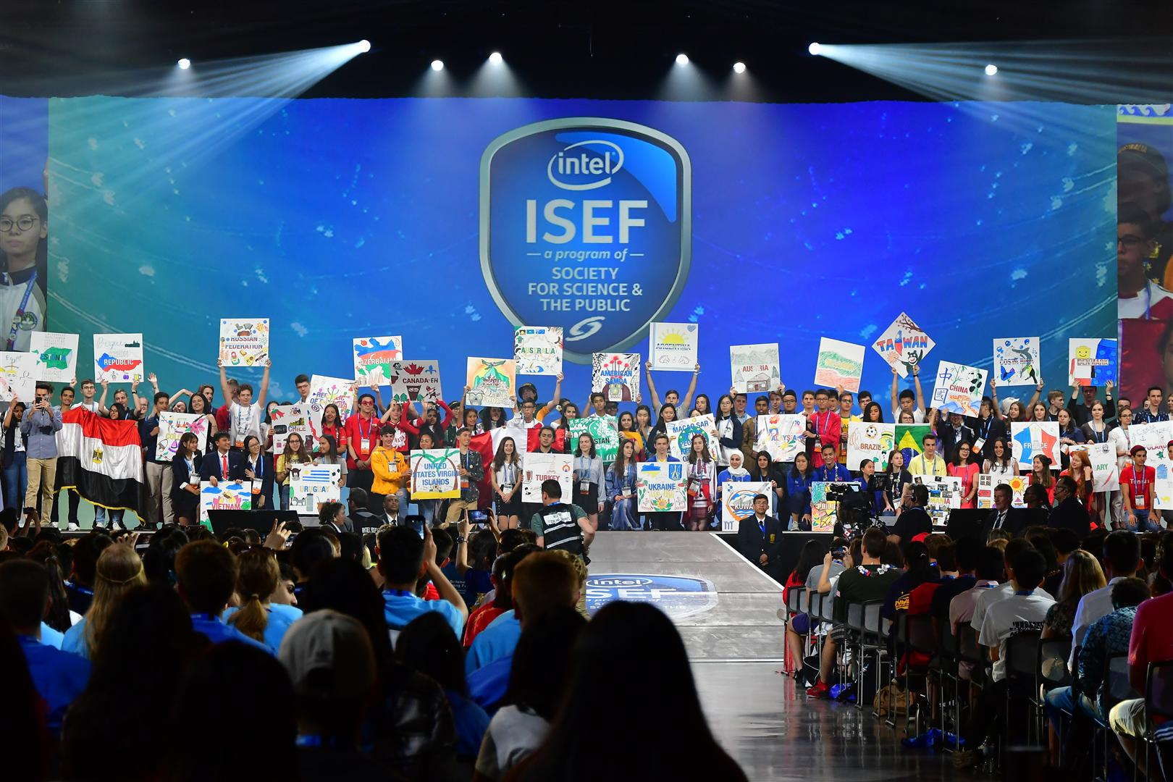

Slide 75
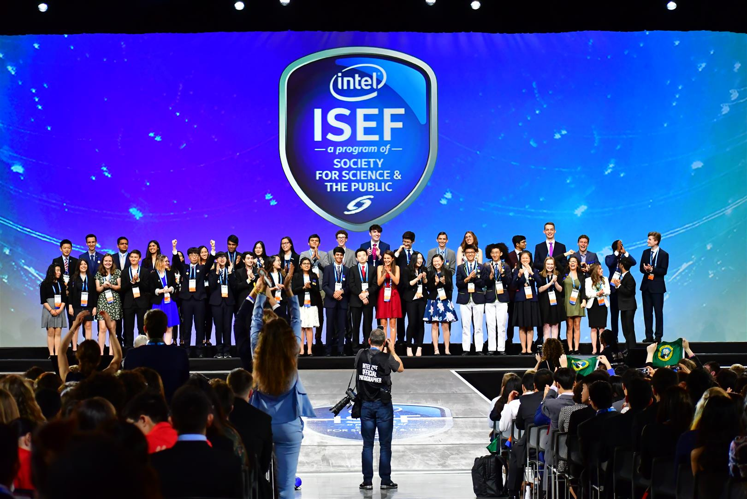

Slide 76
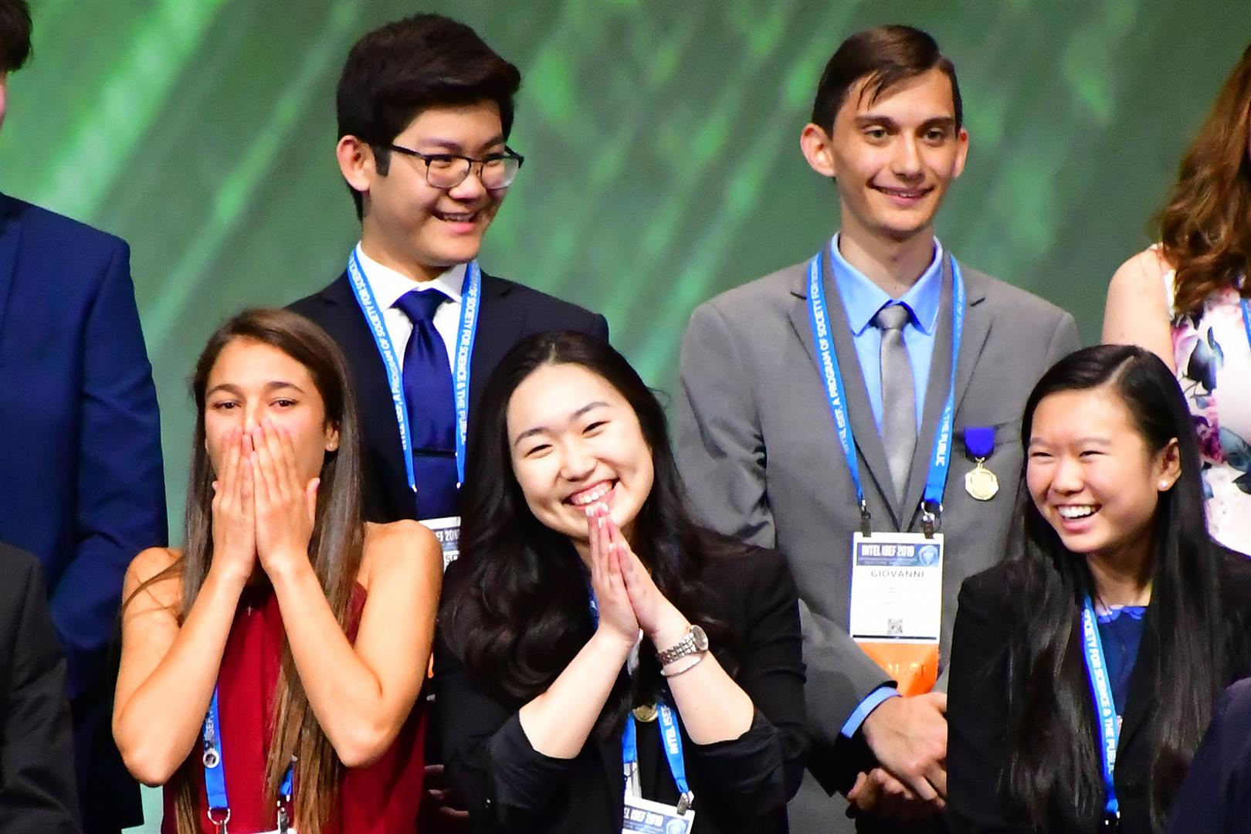

Slide 77
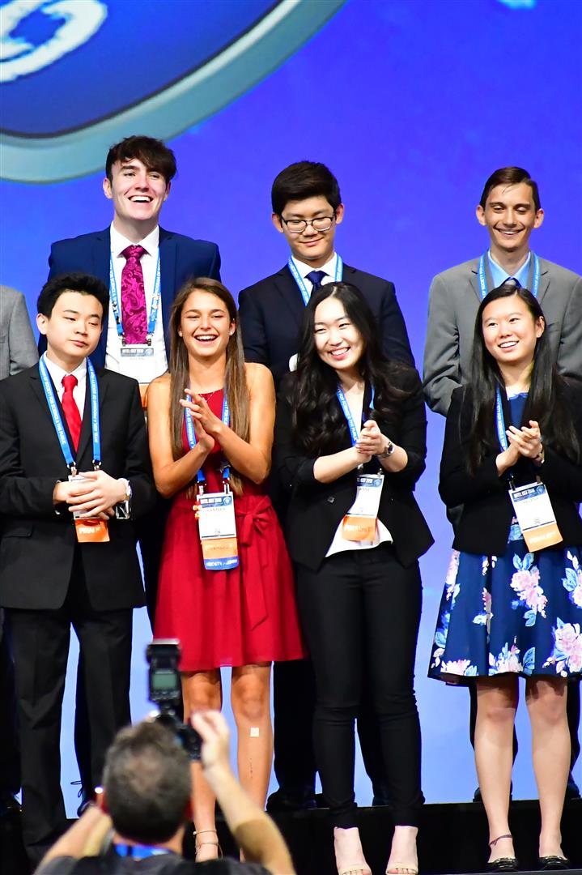

Slide 78
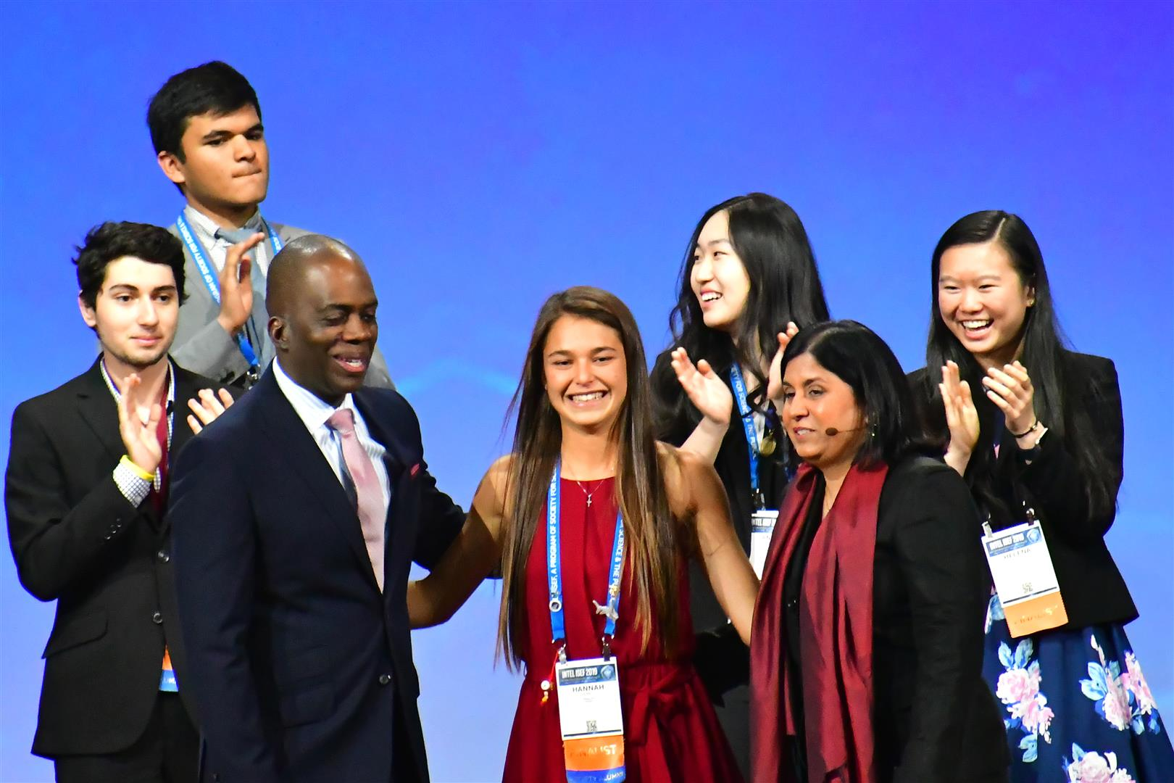
SCAVENGER HUNT!

Slide 79
ISEF/SSEF RULES OVERVIEW
General
  Expanded Ethics Statement
  Roles and Responsibilities of the Students and Adults has been rewritten and reformatted
  Added Responsibilities for Qualified Scientist and Designated Supervisor
Human Participants
  Prohibit students from independently diagnosing diseases
  Expanded definition of
  medical act
Others
  Clarified PHBA rules
  Revised “Engineering Projects Guide”

Slide 80


Slide 81
SRC PRACTICE - SCENARIOS
DIRECTIONS: For each of the scenarios explain:
a. What additional information would you, as an adult sponsor, need before proceeding?
b. Should the project be approved? Why or why not?
c. What supervision is needed?
d. Is the project allowable at home/on farm site? Why or why not?
e. What forms, if any, in addition to 1, 1A, and 1B, are needed?
f. What additional questions/considerations do you have?

Slide 82


