Slide 1
Potentially Hazardous Biological Agents
(PHBA)

Slide 2
Potentially Hazardous Biological Agents - Microorganisms
Studies involving bacteria, fungi, viruses
ALL studies involving the above require a risk assessment to determine biosafety level (BSL), which factors in…
BSL determination of the organism
Techniques involved with culturing and handling the organism
BSL: Defines potential level of harm, injury or disease to plants, animals or humans and involves…
Assignment of biological agent and actual procedure to risk group (BSL designation)
Risk group will determine the required level of containment (BSL-1 or BSL-2 laboratory)
Qualified expertise of adult(s)
1

Slide 3
Biosafety Levels
Biosafety levels involve both procedures AND microorganisms.
BSL 1 Studies (including use of E. coli K12)
Must be conducted in a certified BSL-1 laboratory
Must use appropriate PPE, including lab coat, gloves, goggles
Cannot involve procedures in which organisms are subcultured or plates opened (except for proper disposal by designated supervisor)
BSL 2 Studies
Cannot be performed by Junior Division Researchers
Must be conducted in a certified BSL-2 laboratory
Must use appropriate PPE, including lab coat, gloves, goggles
Must be supervised by a qualified scientist who possesses at least a masters degree or higher in microbiology or a pure science related to microbiology with specific training in microbiological techniques OR a scientific professional meeting the characteristics on p. 5 of the ISEF rulebook (documentation of experience and expertise required)
Includes any procedure that involves the opening of a culturing vessel (ex. Petri dish, culture tube, or flask) after inoculation.
BSL 3 and BSL 4 Studies: PROHIBITED.
2

Slide 4
PHBA Minimum Required Expertise
RE: Qualified expertise of adult(s)
BSL-1 projects must be supervised by a Designated Supervisor (DS)
A DS must possess at least a bachelors degree and specific training in microbiological techniques.
BSL-2 projects must be supervised by a Qualified Scientist (QS)
A QS must possess at least a masters degree or higher in microbiology or a pure science related to microbiology with specific training in microbiological techniques.
AND/OR be a scientific professional meeting the characteristics on p. 5 of the ISEF rulebook (documentation of experience and expertise required)
3

Slide 5
For ALL Studies Involving PHBA’s
Must have prior approval by a scientific review committee (SRC).
Must be conducted in a laboratory environment, NOT at home.
Must use appropriate personal protective equipment (PPE), including but not limited to:
Lab coat
Gloves
Goggles
Must have a research plan, which documents aseptic procedures in detail.
Must document proper disposal techniques, in detail.
Must have a standard microbiological procedures reference in the bibliography.
4

Slide 6
SSEF Rules Supplement for PHBAs
Prohibited Research
Any research involving coronavirus particles
Junior Division: Research conducted on any viruses
Use of wild-collected mushrooms
Use of carbapenem-resistant Enterobacteriaceae (CRE), methicillin-resistant Staphylococcus aureus (MRSA), vancomycin-resistant Enterococci (VRE), or Klebsiella pneumonia carbapenamase (KPC) producing bacteria and other related resistant microbes
Projects designed to produce multiagent or multiple drug-resistant strains of organisms
Subculturing from microbial fuel cells
Unless conducted at a Regulated Research Institution
Projects involving emerging pathogens carried by arthropod vectors (mosquitoes, flies)
5

Slide 7
Special Notes on PHBA’s
Naturally occurring plant pathogens may be studied at home, but may not be cultured or introduced into a home/garden environment.
A project must include PHBA procedures and paperwork if microorganisms are used in any way in the project, even if the focus of the project is not the microorganisms themselves.
Ie. Projects using C. elegans must include PHBA considerations since the worm feeds on a culture of E. coli (to grow the worm, you must grow the microorganism)
Unknown organisms collected from the environment:
It is BSL-1 if…
Organisms cultured in plastic petri dish
Culture dish remains sealed throughout experiment
Culture dish disposed of in appropriate manner [by DS, first submerged in 10% bleach solution and then opened while submerged]
It is BSL-2 if…
Petri dish is opened for examination or subculture
6

Slide 8
Required Forms for PHBA Projects
Form 2—Qualified Scientist form
if applicable; required for BSL-2 projects
Form 3—Risk Assessment form
Form 6A—Potentially Hazardous Biological Agents Risk Assessment Form
BSL-1 or BSL-2 Checklist
Form 1C — Regulated Research Institution/Industrial Setting form
if applicable
7
Notes:
Is a QS form needed for BSL-1 projects?

Slide 9
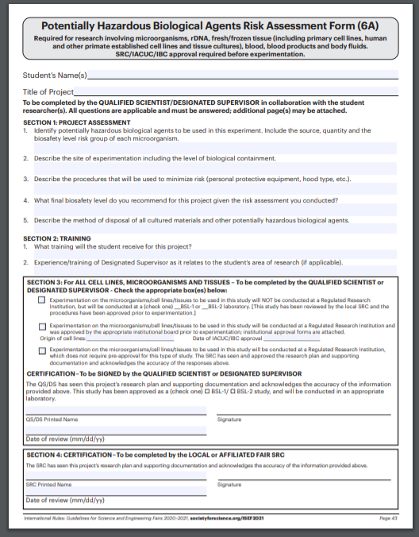
Form 6A
Must be completed by the Qualified Scientist or Designated Supervisor and dated BEFORE any experimental work is started
Must be included in paperwork submitted for the approval by school SRC
8
Notes:
Is a QS form needed for BSL-1 projects?

Slide 10
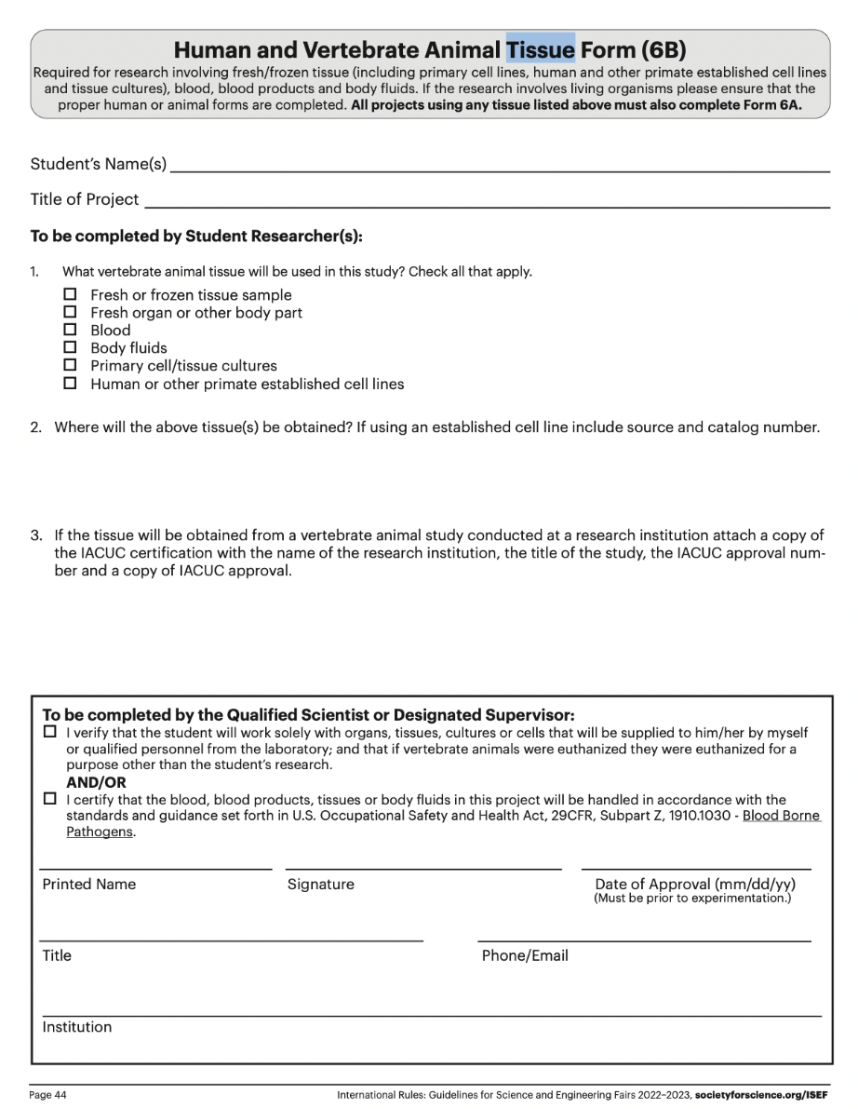
Form 6B
If working with tissues, then a both a Form 6A and 6B are required
Must be completed by the Qualified Scientist or Designated Supervisor and dated BEFORE any experimental work is started
Must be included in paperwork submitted for the approval by school SRC
8
Notes:
Is a QS form needed for BSL-1 projects?

Slide 11
PHBA Projects at Non-School Sites
If a student is performing PHBA research at a location other than the student’s school, the project paperwork must have the following:
Prior to initiation of research:
Completed BSL-1 or BSL-2 Checklist (if not done at an RRI)
Letter of pre-approval on institutional letterhead by the appropriate administrator (such as a dean or department chair for college or university) with complete contact information.
NOTE: The signatory administrator cannot also serve as Adult Sponsor, Qualified Scientist, Designated Supervisor, or School SRC member for the project.
After completion of research:
Form 1C - Regulated Research Institution/Industrial Setting Form
9
Notes:
Is a QS form needed for BSL-1 projects?

Slide 12
Ask us!
If you have ANY questions regarding PHBA procedures or projects, please ask us (and do so before the research begins)!
We are more than happy to screen procedures and make suggestions.
10
Notes:
Is a QS form needed for BSL-1 projects?

