Slide 1
Why Science Fair?

Slide 2
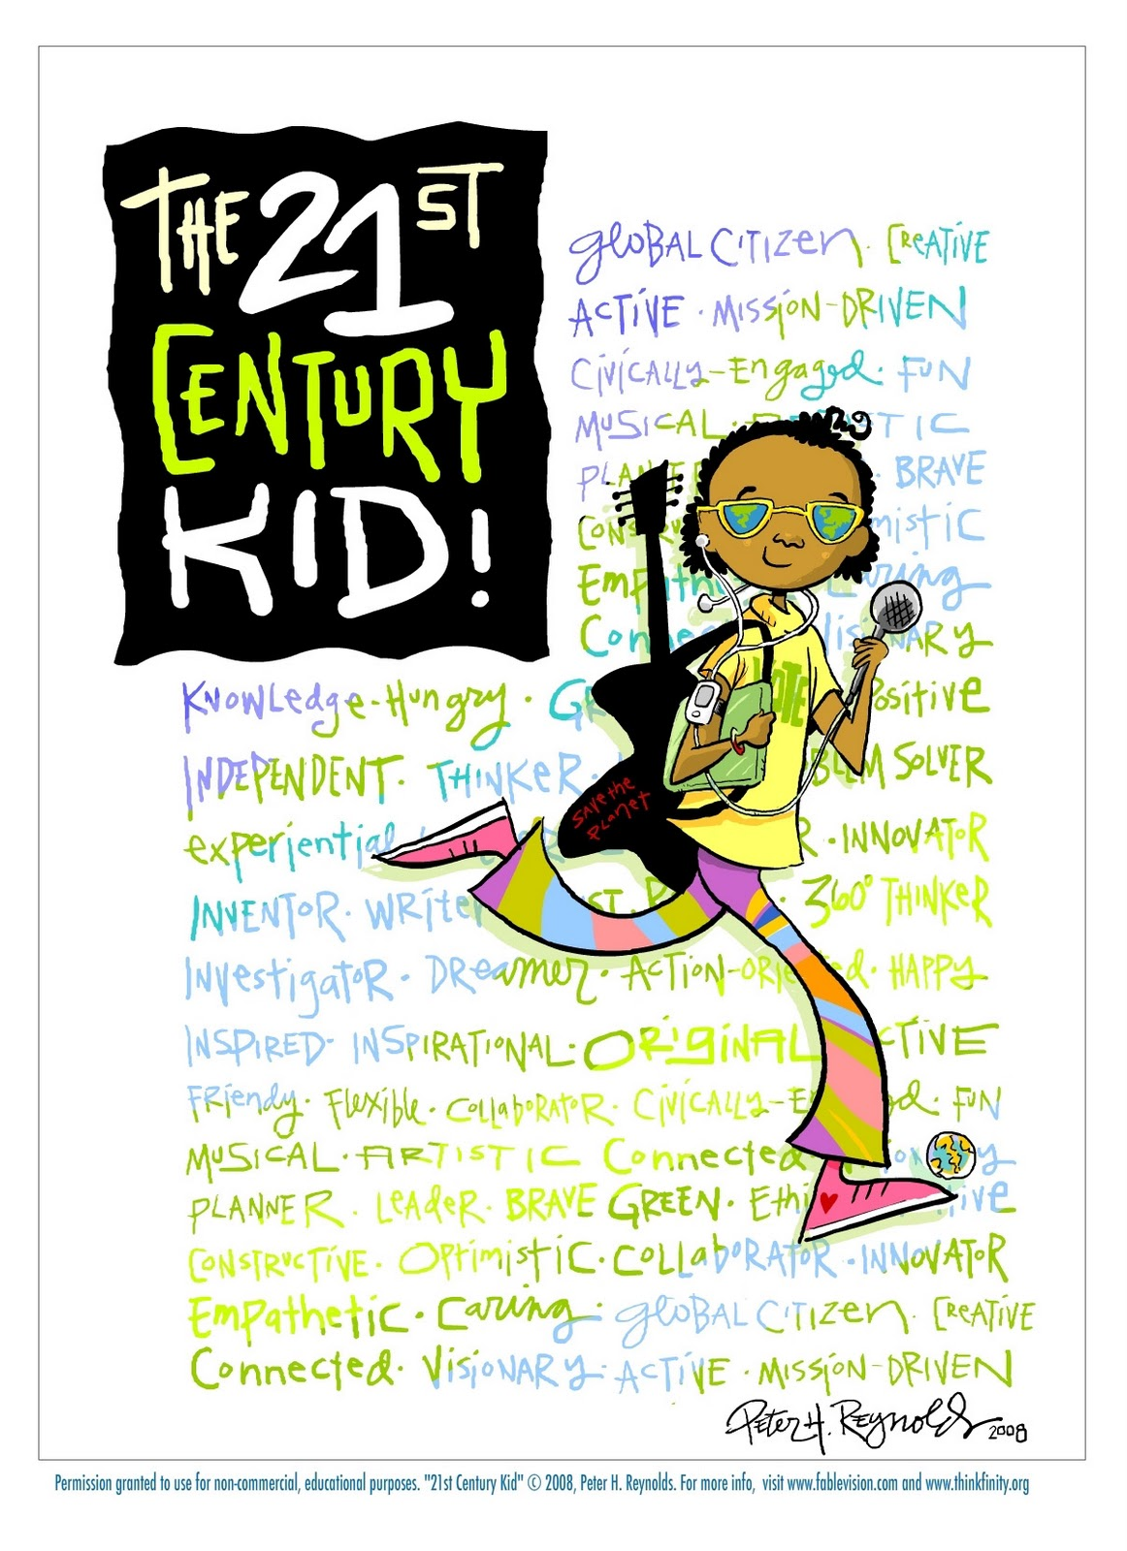

Slide 3
Promoting Positive Attitudes Towards Science
Heightening student interest in science and allow for the exploration of personal interest areas
Promoting the cognitive and intellectual development of students
Providing students with authentic, hands-on experiences through scientific investigation
Engaging students in scientific investigation beyond the routine classroom
Bringing attention to scientific experiences in school
Fostering the development of students’ sense of personal capabilities and qualities

Slide 4
Promoting Positive Attitudes…
Providing the opportunity to recognize and commend scientific accomplishments
Heightening public interest for scientific teaching and learning including the scientific abilities of students
Instilling an appreciation for the relevance of science in daily life
Developing responsibility to serve above yourselves

Slide 5
Developing skills such as…
Following guidelines
Investigating
Conducting Research
Interviewing
Using scientific tools and techniques
Predicting and hypothesizing and inferring
Identifying variables
Observing
Analyzing Data
Interviewing
Preparing reports from research
Preparing displays
Speaking and networking with the public

Slide 6
Supports Common Core Standards such as…..
Reading, writing and research involved in student science fair projects are one way for students to achieve the rigor and critical thinking evident in the Common Core Standards
Cite specific textual evidence to support analysis of science and technical texts
Follow precisely a multistep procedure when carrying out experiments, taking measurements, or performing technical tasks
Integrate quantitative information expressed in words in a text including information expressed visually (graph, etc)
Compare and contrast information
Write informative/explanatory texts, including..scientific procedures/experiments
Summarize numerical data sets in relation to their context

Slide 7
Utilizing the 8 Practices of Science & Engineering Essential for ALL students to Learn Defined as one Dimension in the Next Generation Science Standards Framework s K-12
NGSS
Asking Questions (for science) and defining problems (for engineering)
Developing and using models
Planning and carrying out investigations
Analyzing and interpreting data
Using mathematics and computational thinking
Constructing explanations (for science) and designing solutions (for engineering)
Engaging in argument from evidence
Obtaining, evaluating, and communicating information

Slide 8
Developing 21st Century Skills…
Creativity and innovation
Critical thinking and problem solving
Communication and collaboration
Initiative and self-direction
Productivity and accountability
Information, communication, and technology Literacy

Slide 9
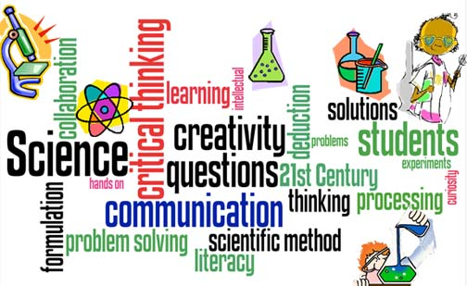
Science - 21st Century Teaching & Learning

Slide 10
The Archimedes Initiative; www.archimedesinitiative.org
Free, online video archive
Students addressing their peers
Recorded at county, state science fairs and ISEF
17 themed videos of high school students information, insight, inspiration, and personal experiences
49 Project video series – individuals discuss research
19 Topic Video series - several students discuss the same topic

Slide 11
Using the Archimedes Initiative
Student Video Content provides practical How-To information
Videos of actual judging day builds confidence when interacting with judges
“Holding Court With Judges”
Videos help teachers and parents learn how to be more effective coaches and supporters
“Straight Talk for Parents and Teachers”
“Using the ‘Folks Factor’ Effectively”
Videos can be used to encourage participation
“What’s in it for me?”
Hear about the value of science fairs straight from students’ mouths – tool for FUND-RAISING

Slide 12
Participant Reflections on Science Fair Experiences…Jeffrey I. Seeman
Fair participants……..
feel they are “stretched” academically and personally
recommend “choosing a project that interests you”
recognize that their own curiosity and interests can lead to compelling research questions and substantive scientific hypothesis
believe their research can and will have meaningful consequences
feel they are “living” the scientific process – just as professionals du
feel welcomed and encouraged to interact with professional scientists
feel they are EXPERTS on their topics

Slide 14
NSTA, The Science Teacher, November 2011, Vol 78, No. 8 SCIENCE FAIR ISSUE
The Science Fair: A New Look at an Old Tradition
Students Inspiring Students – The Archimedes Initiative
Inside the Science Fair: The Judge’s Perspective
The Art of Scientific Ideas – teaching and learning strategies that promote creative problem finding
What Students REALLY Think About Doing Research
Using Inquiry to Break the Language Barrier – ELL and Science Fairs

Slide 15
21st Century Teaching & Learning

