Slide 1
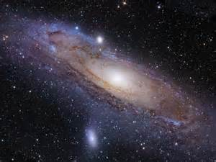
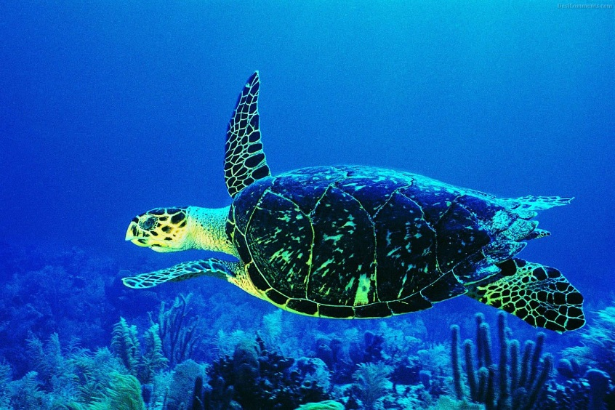
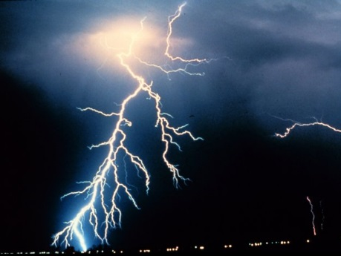
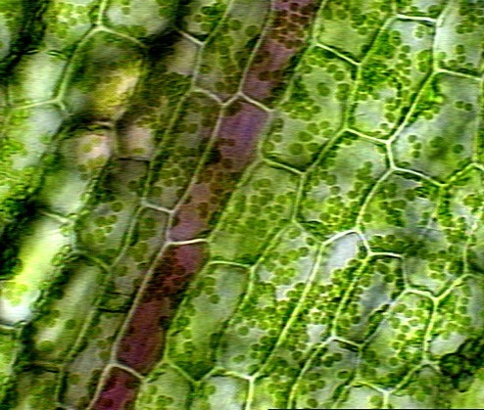
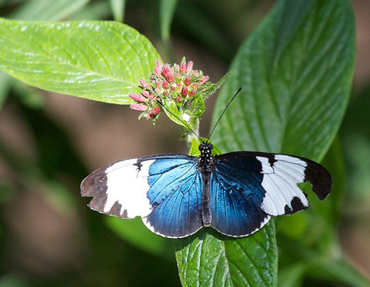
Brevard Regional Science Fairs
Research Teachers Boot Camp August 24, 2015

Slide 2
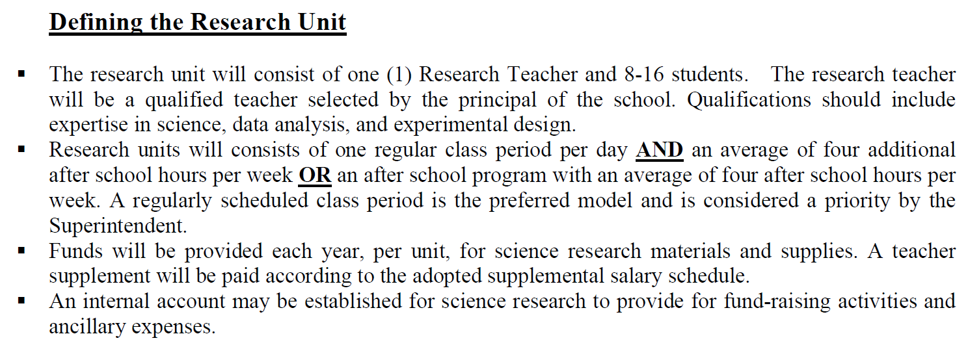
Brevard Regional Science Fairs
Research Teachers Boot Camp August 24, 2015
Note: Student teacher ratio in allocating units may vary from year to year.

Slide 3
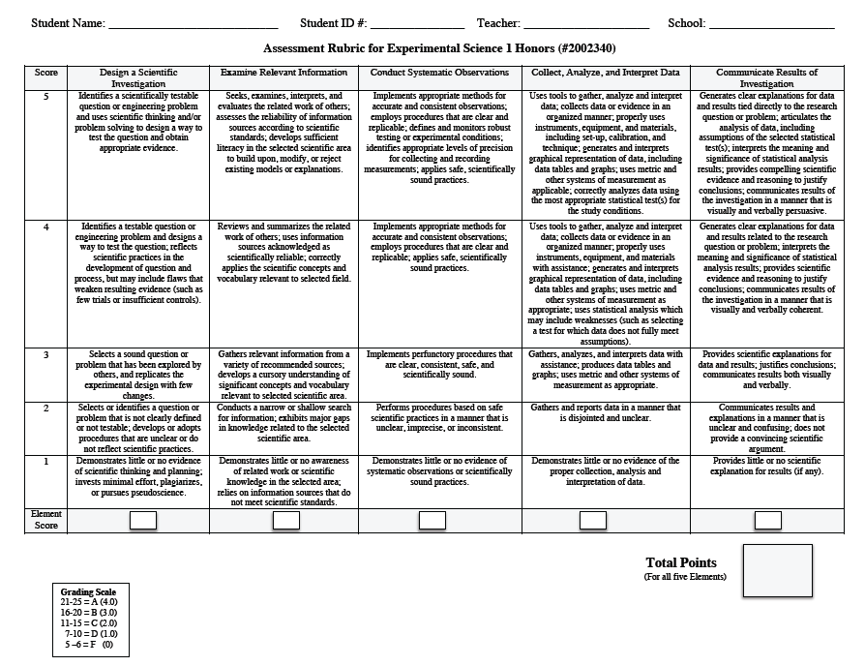
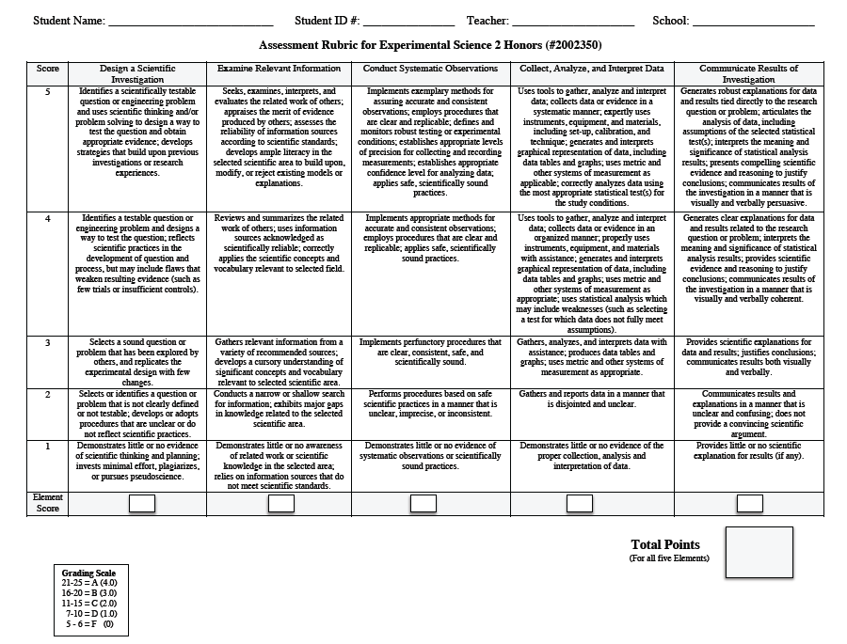
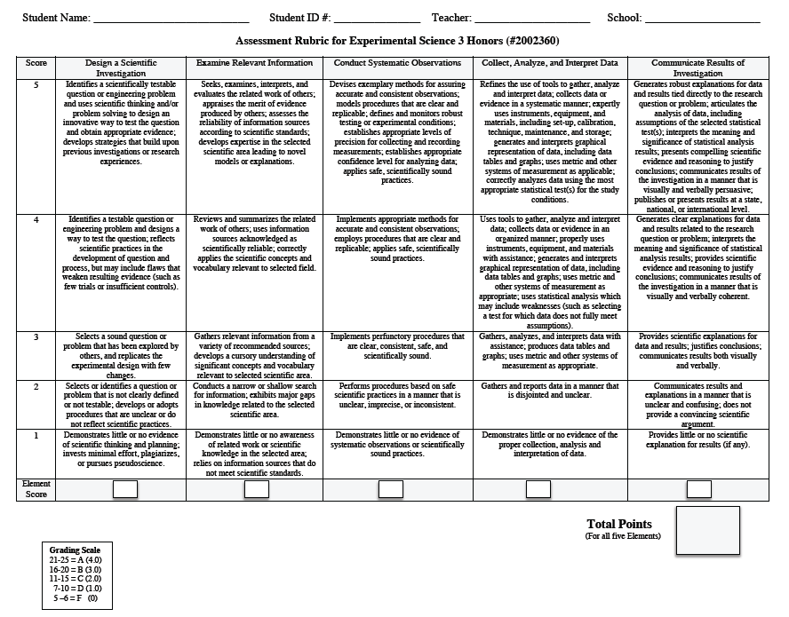
Brevard Regional Science Fairs
Research Teachers Meeting August 24, 2015
Brevard Public School Science Research Rubric Assessment

Slide 4
Brevard Regional Science Fairs
Research Teachers Meeting August 24, 2015
Brevard Public School Science Research Rubric Assessment
District Science Research Funding

Slide 5
BREVARD
Regional Fairs & Directors
Brevard Intracoastal Regional
Science & Engineering Fair
February 4, 5 & 6, 2016
Merritt Square Mall
Brevard Intracoastal
Debbie Austin
DeLaura Middle School
Mary Anderson
West Shore Jr/Sr High
Brevard Mainland
Raul Montes
Cocoa High School
Eliza Gonsalves
Cocoa High School
Brevard South
Elizabeth Youngs
Viera High School
Jasmin Baez
Palm Bay Magnet High School
Brevard Mainland Regional
Science & Engineering Fair
February 11, 12 & 13, 2016
Merritt Square Mall
Brevard South Regional
Science & Engineering Fair
February 18, 19, & 20, 2016
Melbourne Square Mall

Slide 6
Brevard Regional Science Fairs
Research Teachers Boot Camp August 24, 2015
RSEF/SSEF New Categories
Animal Science
Behavioral and Social Sciences
Biomedical and Health Sciences
Cellular and Molecular Biology and Biochemistry
Chemistry
Earth and Environmental Sciences
Engineering
Environmental Engineering
Mathematics and Computational Sciences
Intelligent machines, Robotics and Systems Software
Microbiology
Physics and Astronomy
Plant Science

Slide 7
Where are the forms?!?!
Brevard County Science Fair..(Edline)
http://www.edline.net/pages/Cocoa_High_School/Academics/Resources/Science/Science_Research
BSEND https://brevard.blackboard.com/

Slide 8
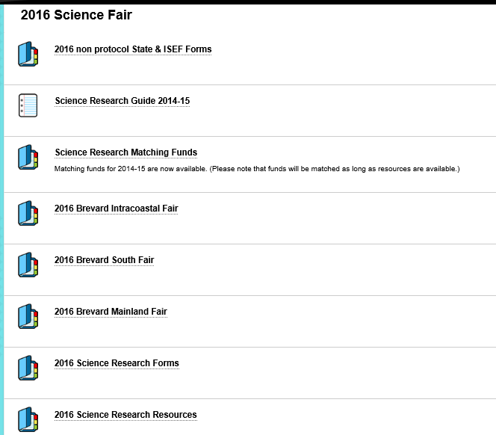
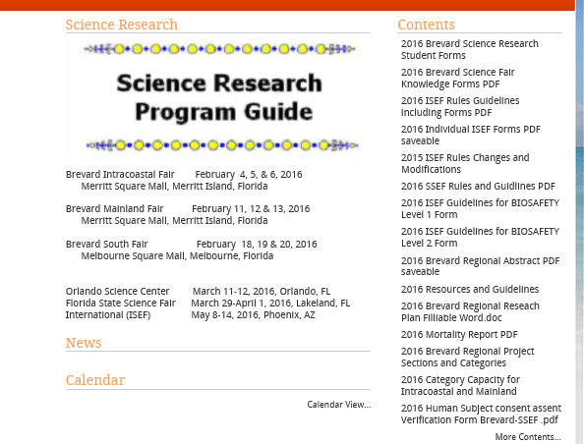
BSEND is available to registered Brevard Public Schools science teachers… look in “Documents & Forms” … Brevard Science Research, 2016 Science Fair…
Edline web page is available to students, parents and teachers.

Slide 9
What do I do once I find the forms?
Click on form
Download said form
Save said form (nomenclature)
Fill in the form
Save form again
Bask in the victory of having filled and saved the document properly

Slide 10
Forms, forms and more forms
Knowledge Forms
Research Teacher
All knowledge
By “category”

Slide 11
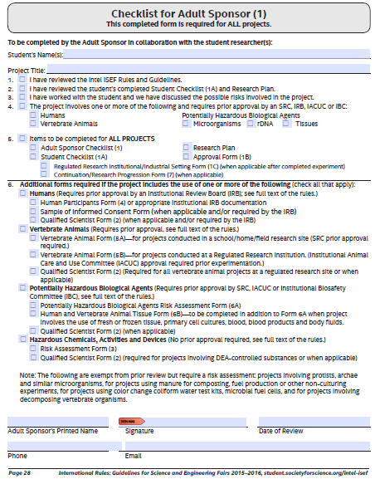
Form 1 is required of all projects.
Form 1 is a fillable and savable form
Make sure that areas pertaining to the project are indicated.
Signatures and dates in blue ink or electronic signature applied.

Slide 12
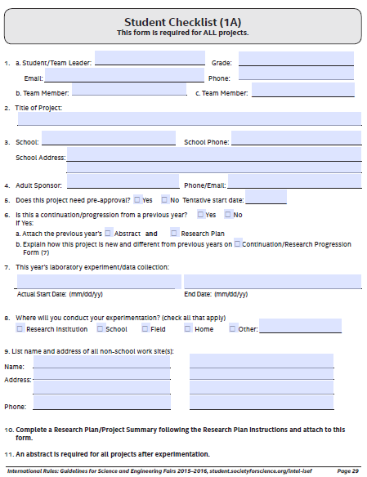
Form 1A is required of all projects.
Form 1A is a fillable and savable form
Start dates are of the experimentation portion of the project.

Slide 13
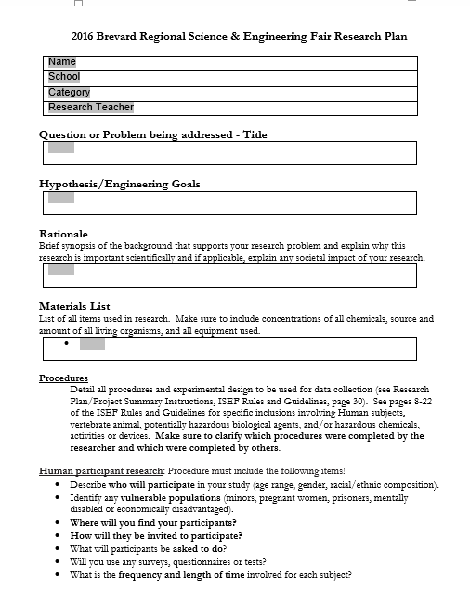
Research Plan is required of all projects.
New items have been added to the Brevard Regional Research Plan template…
Rationale … Brief synopsis of the background that supports your research problem and explain why this research is important scientifically.
Materials List … bulleted list of all items used in research… includes concentration of chemicals and source and amount of all living organisms.
List of requirements!

Slide 14
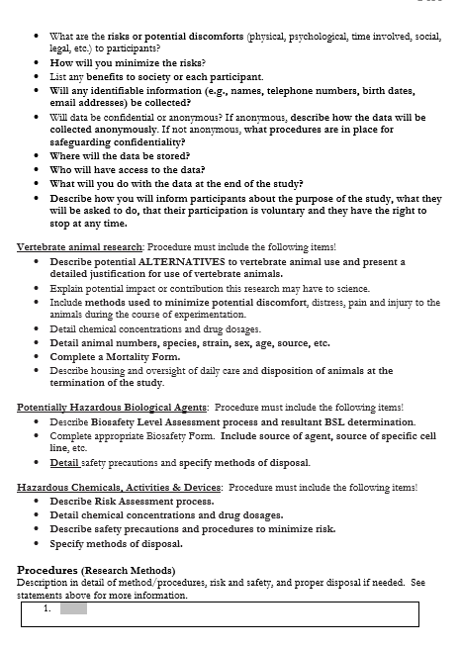
Research Plan is required of all projects.
Template is a Word.doc Form… you may cut and paste… note bulleted and numbered items.
Procedure (Research Methods) … numbered … make sure to include all requirements listed for a particular area of research.
List of requirements!
Please make sure that students include all requirements listed for a particular area of research!

Slide 15
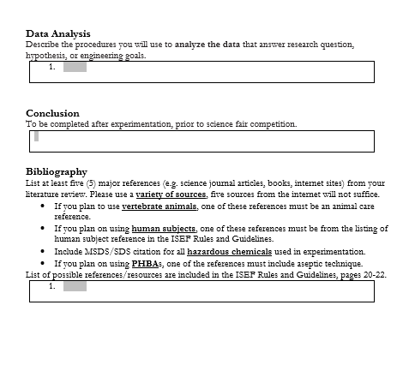
Research Plan is required of all projects.
The template boxes expand as text is entered. Pages are numbered in the top right hand corner.
Data Analysis … numbered … please remember that “Data Analysis” is not a description of how data is to be displayed but an analysis of the data collected.
Conclusion … Conclusion of research at the end of experimentation.
Bibliography … numbered … please make sure to include required citations (depending on nature of research). Sources should be diverse.
List of requirements!

Slide 16
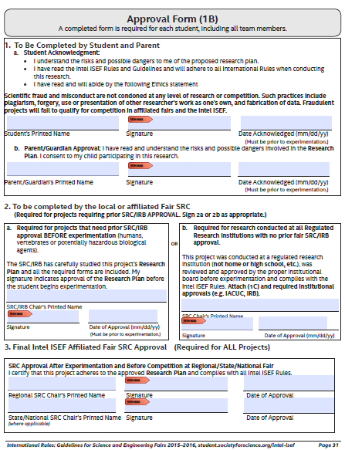
Form 1B is required of all projects.
Form 1B is a fillable and savable form
Signatures and dates in blue ink or electronic signature applied.
Some projects require SRC approval before experimentation. All projects must be reviewed by fair directors before experimentation.
Projects involving human subjects must go SRC then IRB and then be resubmitted to SRC for final approval.

Slide 17
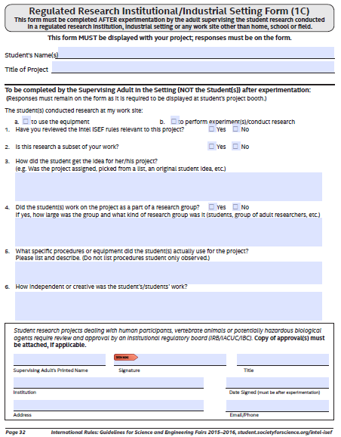
Form 1C is required of some projects.
Form 1C is a fillable and savable form
Please make sure that all questions are answered appropriately.
Determination of requirement is established by SRC and rules/guidelines.
Signatures and dates in blue ink or electronic signature applied.
This is the only form that should be dated after the start of experimentation.

Slide 18
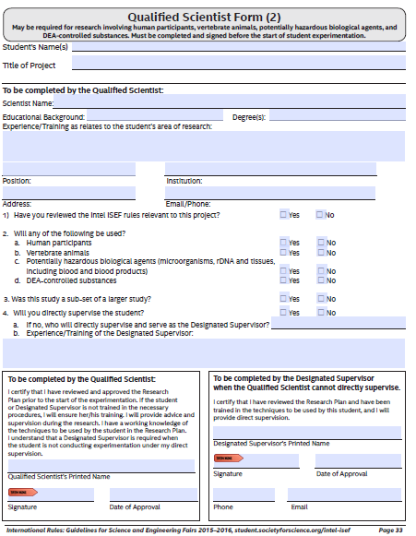
Form 2 is required of some projects.
Form 2 is a fillable and savable form.
Please make sure that all questions are answered appropriately.
Determination of requirement is established by SRC/IRB and rules/guidelines.
Signatures and dates in blue ink or electronic signature applied.

Slide 19
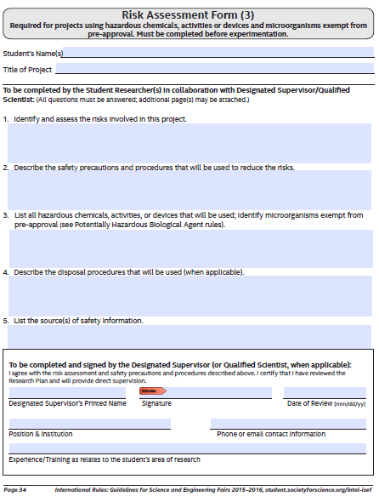
Form 3 is required of most projects.
Form 3 is a fillable and savable form
Please make sure that all questions are answered appropriately.
Make sure to list appropriate sources off safety information.
Determination of requirement is established by SRC/IRB and rules/guidelines.
Signatures and dates in blue ink or electronic signature applied.

Slide 20
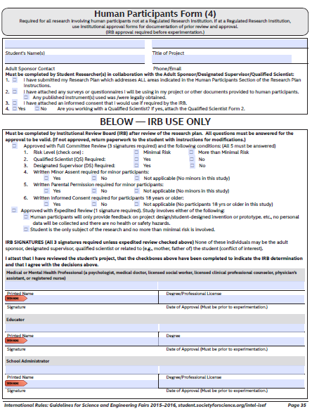
Form 4 is required of all projects involving human subjects.
Form 4 is a fillable and savable form.
Level of risk is determined by the IRB.
Determination of requirement is established by SRC/IRB and rules/guidelines.
Form 4 must be completed AND SRC approval must be obtained before projects involving humans may begin.
Signatures and dates in blue ink or electronic signature applied.

Slide 21
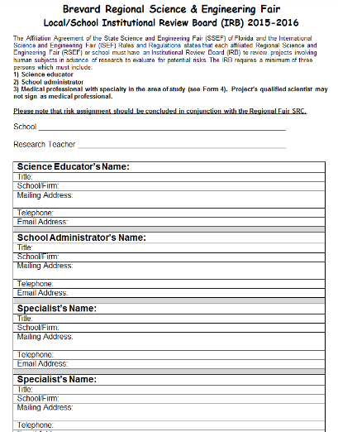
Form 4 requires review by an Institutional Review Board (IRB).
An IRB requires at least three members not associated with student’s research in order to rule out a conflict of interest.
Note that “Specialist” must have credentials in area being reviewed.
Brevard Regional Fairs will not be accepting expedited reviews.
Form 4 must be completed AND SRC approval must be obtained before projects involving humans may begin.

Slide 22
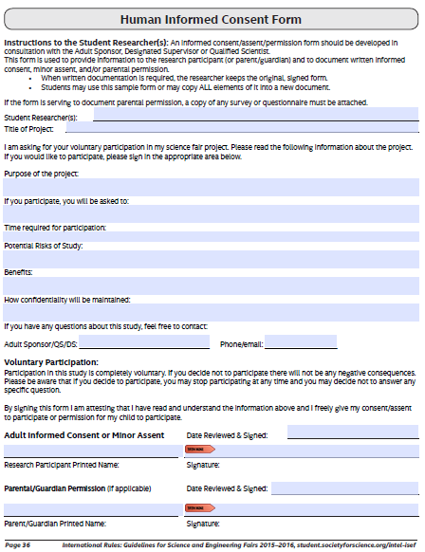
Informed Consent Form is the required consent form for Brevard Regional Fairs when IRB from form 4 indicates this as a required document.
Signatures and dates in blue ink or electronic signature applied.

Slide 23
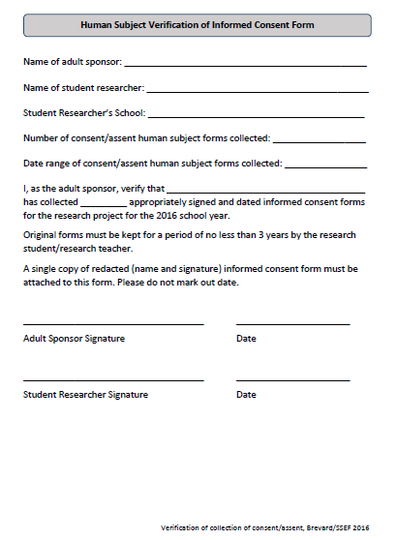
Human Subject Verification of Informed Consent Form NEW FORM … required form at setup prior to judging, along with one redacted copy … form used to verify that consent/assent form was obtained from each human subject. To be completed by adult sponsor and student researcher.
Signatures and dates in blue ink or electronic signature applied.

Slide 24
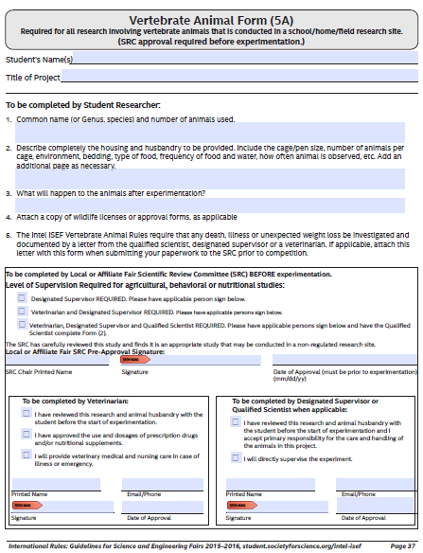
Form 5A is required of some projects.
Form 5A is a fillable and savable form
Determination of requirement is established by SRC and rules/guidelines.
Required of projects involving vertebrates at school or home.
Signatures and dates in blue ink or electronic signature applied.

Slide 25
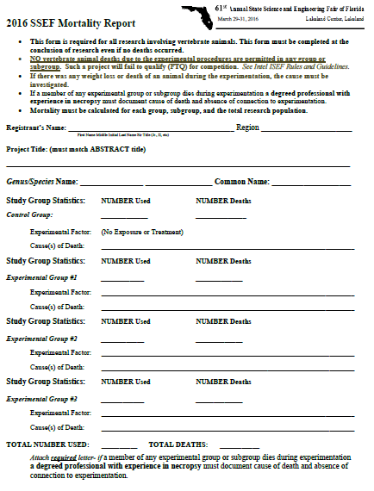
Mortality Report is required of all projects involving vertebrate animals, even if no deaths occurred.
Mortality Report is a fillable and savable form.

Slide 26
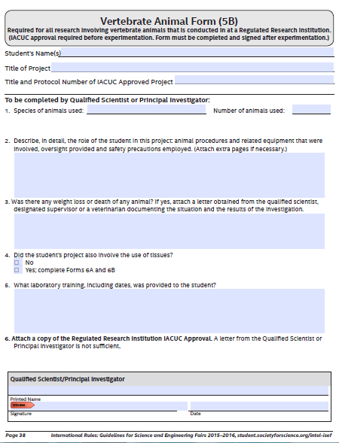
Form 5B is required of some projects.
Form 5B is a fillable and savable form
Determination of requirement is established by SRC and rules/guidelines.
Required of projects involving vertebrates at registered research institutions.
Signatures and dates in blue ink or electronic signature applied.

Slide 27
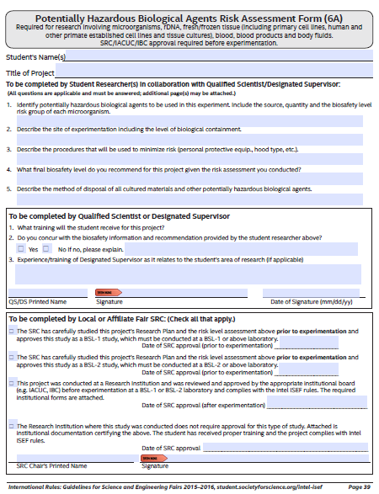
Form 6A is required of some projects.
Form 6A is a fillable and savable form
Level of risk must be determined, BSL-1 or BSL-2.
Determination of requirement is established by SRC and rules/guidelines.
Required of projects involving potentially hazardous biological agents. JUNIOR CATEGORY MAY NOT SUBMIT BSL-2 PROJECTS.
Signatures and dates in blue ink or electronic signature applied.

Slide 28
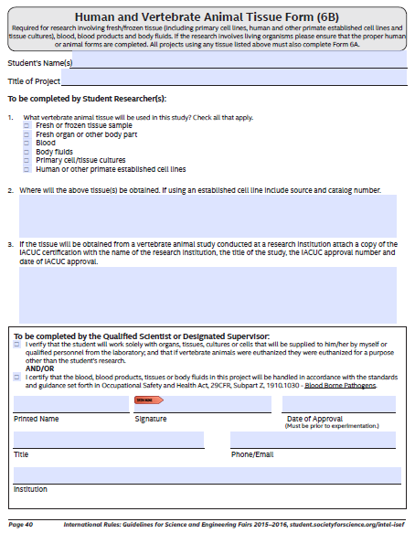
Form 6B is required of some projects.
Form 6B is a fillable and savable form.
Determination of requirement is established by SRC and rules/guidelines.
Required of projects involving human and vertebrate tissue.
Signatures and dates in blue ink or electronic signature applied.

Slide 29
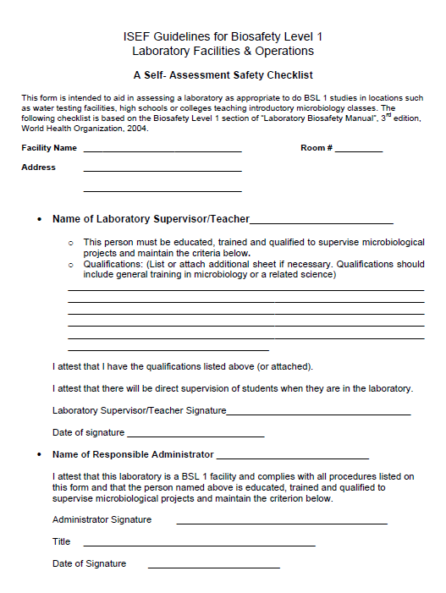
BREVARD Guidelines for Biosafety Level 1 Laboratory Facilities & Operations.
Required of projects involving PHBA at a Biosafety Level of 1.
Determined by the completion of the risk assessment for PHBA, Form 6A.
Signatures and dates in blue ink or electronic signature applied.
Page ONE of 2.
PAGE 1

Slide 30
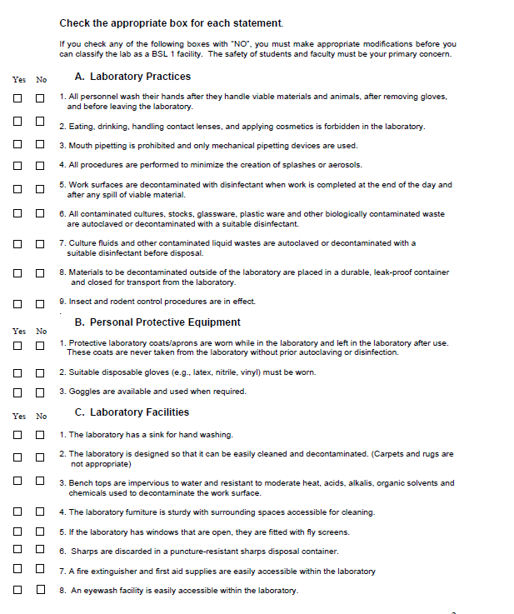
BREVARD Guidelines for Biosafety Level 1 Laboratory Facilities & Operations.
Required of projects involving PHBA at a Biosafety Level of 1.
Determined by the completion of the risk assessment for PHBA, Form 6A.
Signatures and dates in blue ink or electronic signature applied.
Page TWO of 2.
PAGE 2

Slide 31
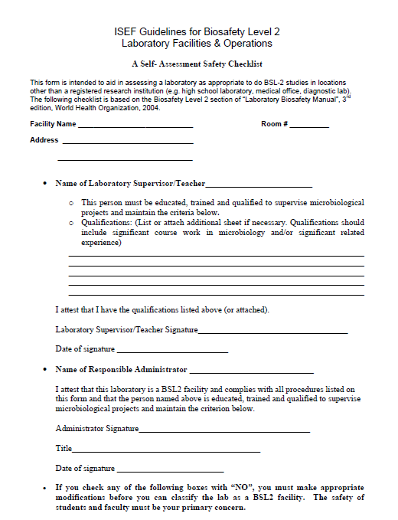
ISEF Guidelines for Biosafety Level 2 Laboratory Facilities & Operations.
Required of projects involving PHBA at a Biosafety Level of 2.
Determined by the completion of the risk assessment for PHBA, Form 6A.
Signatures and dates in blue ink or electronic signature applied.
Page ONE of 3.
PAGE 1

Slide 32
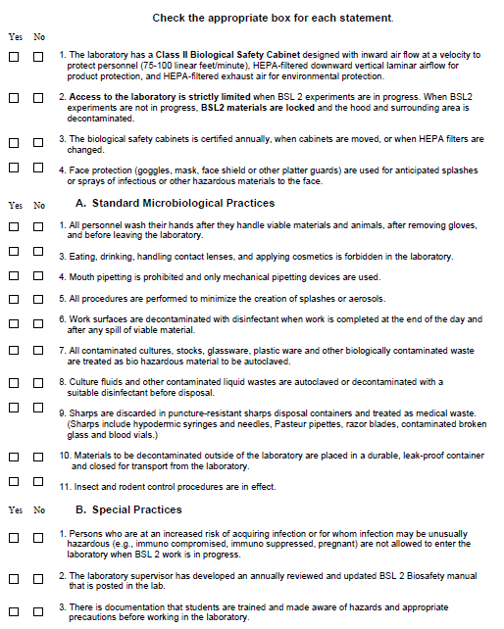
ISEF Guidelines for Biosafety Level 2 Laboratory Facilities & Operations.
Required of projects involving PHBA at a Biosafety Level of 2.
Determined by the completion of the risk assessment for PHBA, Form 6A.
Signatures and dates in blue ink or electronic signature applied.
Page TWO of 3.
PAGE 2

Slide 33
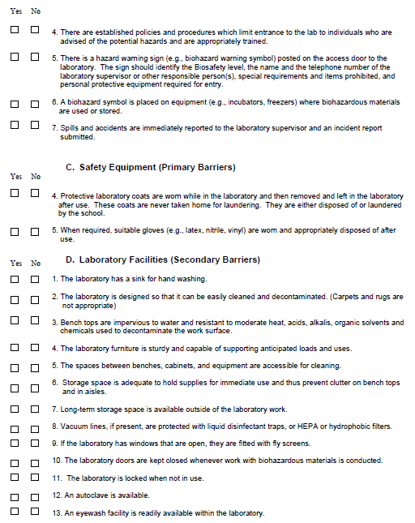
ISEF Guidelines for Biosafety Level 2 Laboratory Facilities & Operations.
Required of projects involving PHBA at a Biosafety Level of 2.
Determined by the completion of the risk assessment for PHBA, Form 6A.
Signatures and dates in blue ink or electronic signature applied.
Page THREE of 3.
PAGE 3

Slide 34
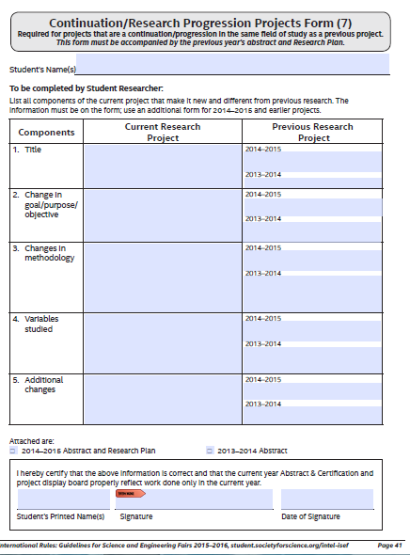
Form 7 is required of some projects.
Form 7 is a fillable and savable form
Determination of requirement is established by SRC and rules/guidelines.
Required of projects which are a continuation of previous research.
Signatures and dates in blue ink or electronic signature applied.

Slide 35
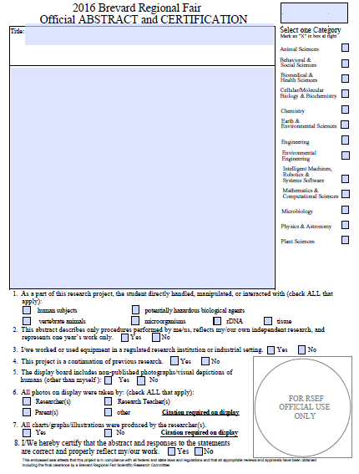
Regional Fair Abstract is required of all projects.
Regional Fair Abstract is a fillable and savable form.
Original will be reviewed and certified. This certified abstract is to be placed in the lower left hand corner of researcher’s display.

Slide 36
Brevard Regional Science Fairs
Research Teachers Boot Camp August 24, 2015
Technology Integration
Students & Teachers should learn to complete fillable forms and save appropriately.
Students & Teachers should become familiar with cloud/sharing such as Google Docs/Drive… https://sites.google.com/a/share.brevardschools.org/integratorsgoogleresources/
Teachers should learn to use Skype for Business… part of your Office 365. Need webcam, video and audio.

Slide 37
Safe Science
Make sure you look at the Safety Manual
https://brevard.blackboard.com/bbcswebdav/pid-13915-dt-content-rid-82352_1/orgs/BPS_Science_Educator_Network/Safe%20Science%202014.pdf
Must ensure that chemicals are on the approved chemicals list (starts on pg 79)
Any chemical needing approval will need a form (pg 66) filled out and sent to Ginger Davis

Slide 39
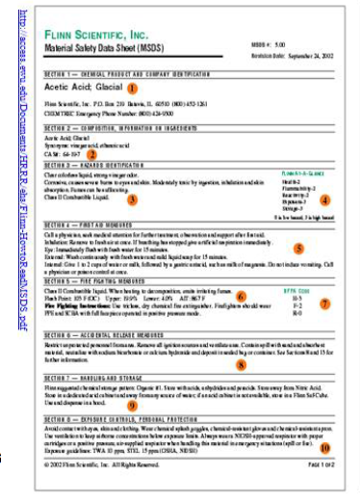
MSDS
Citation should be included in research plan bibliography
Need to be on Form 3

Slide 40
Brevard Regional Science Fairs
Research Teachers Meeting August 24, 2015
Reminders &
RSEF/SSEF/ISEF Rule Changes
Teams at Regions, State & ISEF will compete in the category of their choice.
Continuation projects no longer require prior years Form 1A.. Just research plan and abstract along with Form 7
Behavioral vertebrate projects are prohibited which include operant conditioning with aversive stimuli.
Even though ISEF is permitting MRSA and VRE projects, Brevard Regional Fairs will not permit these projects… NO BSL2 projects in Junior Section.

Slide 41
Brevard Regional Science Fairs
Research Teachers Meeting August 24, 2015
Reminders &
RSEF/SSEF/ISEF Rule Changes
No vertebrate animal deaths due to the experimental procedures are permitted in any group or subgroup. Such a project will fail to qualify for competition.
Any death which occurs must be investigated by an individual qualified to determine the cause of death, such as a veterinarian. The results of the investigation must be documented in writing.

Slide 42
Brevard Regional Science Fairs
Research Teachers Meeting August 24, 2015
Reminders &
RSEF/SSEF/ISEF Rule Changes
Studies involving livestock or fish that are being raised for food using standard agriculture / aquaculture production practices are allowed. The livestock or fish may be euthanized by a qualified adult for carcass evaluation.

Slide 43
Brevard Regional Science Fairs
Research Teachers Meeting August 24, 2015
Reminders &
RSEF/SSEF/ISEF Rule Changes
Studies involving the decomposition of vertebrate organisms (such as in forensic projects) require a Risk Assessment Form 3.
Human and other primate established cell lines and tissue cultures are to be treated as potentially hazardous biological agents. Plant and non-primate established cell lines and tissue culture collections do not need to be treated as potentially hazardous biological agents.

Slide 44
Brevard Regional Science Fairs
Research Teachers Meeting August 24, 2015
Reminders &
RSEF/SSEF/ISEF Rule Changes
Vertebrate Animal Form 5A …. question regarding weight loss or death of any animal. If weight loss or death occurred, the student needs to attach documentation from qualified individual.
Vertebrate Animal Form 5B …. question regarding weight loss, gain or death of any animal. If weight loss or death occurred, the student needs to attach documentation from qualified individual.

Slide 45
Brevard Regional Science Fairs
Research Teachers Meeting August 24, 2015
Reminders &
RSEF/SSEF/ISEF Rule Changes
The use of E.coli K-12 in projects requires prior SRC approval. NOTE: This is stricter than INTEL ISEF Rules/Guidelines.
Any project requiring IRB must first be submitted to the SRC then will be submitted to the IRB. This project must then be resubmitted to the SRC for final approval.

Slide 46
Brevard Regional Science Fairs
Research Teachers Meeting August 24, 2015
Brevard Regional Fair Concerns
Mentors must be aware of rules… and rules must be implemented.
IRB… can be set up by schools… Professionals must be in field of research…
Students, teachers and all involved must become aware of risks while conducting research…

Slide 47
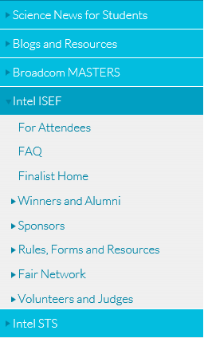
Brevard Regional Science Fairs
Research Teachers Boot Camp August 24, 2015
Research Teachers must…
Become familiar with ISEF and SSEF Rules and Guidelines… https://student.societyforscience.org/intel-isef and http://www.floridassef.net/

Slide 48
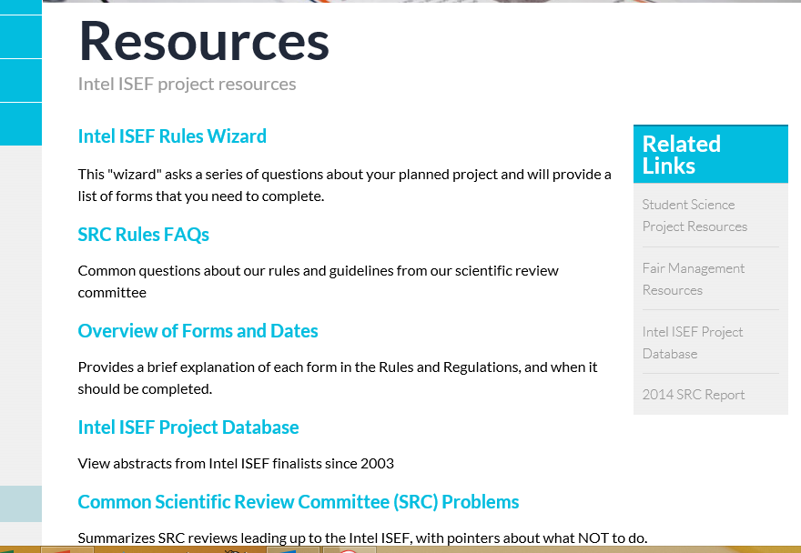

Slide 49
Brevard Regional Science Fairs
Research Teachers Boot Camp August 24, 2015
Internet Sites
Biological Safety Level sites… www.cdc.gov/od/ohs/symp5/jyrtext.htm
ISEF Rules on the Web…
https://student.societyforscience.org/intel-isef
Brevard County Science Fair..(Edline)
http://www.edline.net/pages/Cocoa_High_School/Academics/Resources/Science/Science_Research

Slide 50
Brevard Regional Science Fairs
Research Teachers Meeting August 31, 2015
Internet Sites
Science Buddies… http://www.sciencebuddies.org/
ISEF abstract database… https://apps2.societyforscience.org/abstracts/
Brevard Public Schools Science Curriculum http://www.edline.net/pages/Brevard_County_Schools/Departments/Departments__A-J/Curriculum_and_Instruction/Groups/High_School_Science

Slide 51
Project Categories
Regional Fair Categories
ANIM 100 Animal Sciences
BEHA 200 Behavioral and Social Sciences
BMED 300 Biomedical and Health Sciences
CMBI 400 Cellular/Molecular Biology &Biochemistry
CHEM 500 Chemistry
EAEV 600 Earth and Environmental Sciences
ENMS 700 Engineering (Engineering Mechanics, Material Science, Embedded Systems)
ENEV 800 Environmental Engineering
IMRS 900 Intelligent Machines, Robotics and Systems Software
MACO 1000 Mathematics and Computational Sciences
MICR 1100 Microbiology
PHYS 1200 Physics & Astronomy
PLNT 1300 Plant Sciences
Junior Projects X51 through X99 for each category above (grades 6-8).
Senior Projects X01 through X49 for each category above (grades 9-12)

Slide 52
Project Categories

Slide 53
Adult Roles and Responsibilities
Adult Sponsor
Designated Supervisor
Qualified Scientist
IRB
SRC

Slide 54
Adult Sponsor
Oversees project
Completes Form 1 – Checklist for Adult Sponsor
Usually the science teacher

Slide 55
Designated Supervisor
Supervises project when Qualified Scientist cannot directly supervise
“Animal Care Supervisor” for animal projects
Supervises projects using Hazardous Chemicals, Activities or Devices

Slide 56
Qualified Scientist
Required for some projects
Doctoral/professional degree related to student research
Completes Form 2 – QS Form

Slide 57
IRB (Institutional Review Board)
Reviews human subject studies
Membership
educator
school administrator
someone knowledgeable about evaluating risk: MD, PA, RN, psychiatrist, psychologist, licensed social worker (knowledgeable in the area of the research being evaluated)

Slide 58
SRC (Scientific Review Committee)
Review all projects BEFORE experimentation
Review all projects just prior to competition
Membership
biomedical scientist (Ph.D., M.D., D.V.M., D.D.S., D.O.)
science teacher
other members

Slide 59
Research sites
Examples of non-regulated sites
Home
School
Farm
Ranch
Field
Examples of regulated site
IACUC Review and Approval process
Universities
Government research agencies
Private research laboratories / hospitals

