Slide 1



WELCOME

Slide 2


Slide 3
Florida Foundation for Future Scientists, Inc. is proud to present
The 63rd State Science and Engineering Fair of Florida
STEM Competition
March 27 - 29, 2018
The Lakeland Center, Lakeland

Slide 4
INTRODUCTIONS
FFFS Board of Directors
Fair Directors
SSEF Scientific Review Committee
RSEF Representatives/Coordinators

Slide 5
SETTING UP A LOG BOOK
Number the front of each page on the right lower corner -
Do not number on back of page
Page 1 – Title Page – Name – August 25th, 2017 – SSEF Workshop
Page 2 – Table of Contents
Page 3 – 8 - Begin Timeline

Slide 6
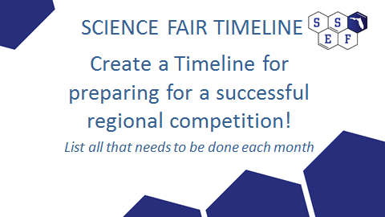

Slide 7
SCIENCE FAIR TIMELINE
Page 3: July/August
Page 4: September/October
Page 5: November/December
Page 6: January/February
Page 7: March/April
Page 8: May/June

Slide 8
RSEF DIRECTOR
Ensures proper management of the science fair
Ensures that all fair programs and activities are adequately and appropriately planned, supervised, resourced, and staffed with qualified personnel/volunteers
Undertakes long range and strategic planning to accomplish the fair’s mission and goals
Maintains appropriate relations with fair’s staff, volunteers, members of the community of stakeholders – schools, school system, teachers, students, parents, etc
Maintains documentation of all the operational processes of the fair
…………and

Slide 9


Slide 10
Rules & Guidelines for
Science Research
The purpose of Rules for science research competitions are to:
Protect the rights and welfare of the student researcher
Protect the rights and welfare of human participants/subjects
Protect the health and welfare of vertebrate animals
Ensure adherence to state (FL) and federal regulations
Ensure use of safe laboratory practices
Protect the environment
Determine eligibility for competition

Slide 11
Ethics and Science Research
The science research student is responsible for maintaining the highest ethical standards throughout their scientific pursuits.
Teachers and students are required to..
Be dedicated to the pursuit of beneficial scientific investigation
Discuss, manage, evaluate, and report scientific data honestly
Not plagiarize or falsify any part of the research
Encourage constructive criticism of the research
Ensure protection

Slide 12
SRC REVIEW OF PROJECTS
PRACTICE

Slide 13
Responsibilities of the
Scientific Review Committee(SRC)
The SRC is a group of qualified individuals responsible for evaluation of student research, certifications, research plans and exhibits for compliance with the rules, laws and regulations at each level of competition.
Must consist of a minimum of 3 persons – a biomedical scientist with earned doctoral degree, an educator, and at least one additional educator
It is recommended to make up the SRC with additional members to diversify and increase the expertise of the committee. (in areas such as biosafety, animal care, hazardous chemicals/equipment, etc.
Research projects involving vertebrate animals, PHBA’s, hazardous chemicals, activities, devices, and (human subjects IRB) must be approved PRIOR to experimentation
ALL projects must be reviewed and approved AFTER experimentation
and prior to competition.

Slide 14
Responsibilities of the
Institutional Review Board (IRB)
IRB MUST evaluate the potential physical and psychological risk of research involving humans (federal regulations). (Human Participant Form 4)
Thoroughly review the Human Participant Rules for Intel ISEF ( pages 8 – 10) and SSEF of Florida (page 1)
IRB MUST review any proposed human research BEFORE experimentation begins
IRB should be established at the school level (Required: an educator, school administrator, and medical/health professional)
Conflict of interest – (no Adult Supervisor, parent/relative, Qualified Scientist or Designated Supervisor should be the IRB reviewing project)
Adult sponsor and local IRB are responsible for ensuring that the project is
appropriate for pre-college research

Slide 15
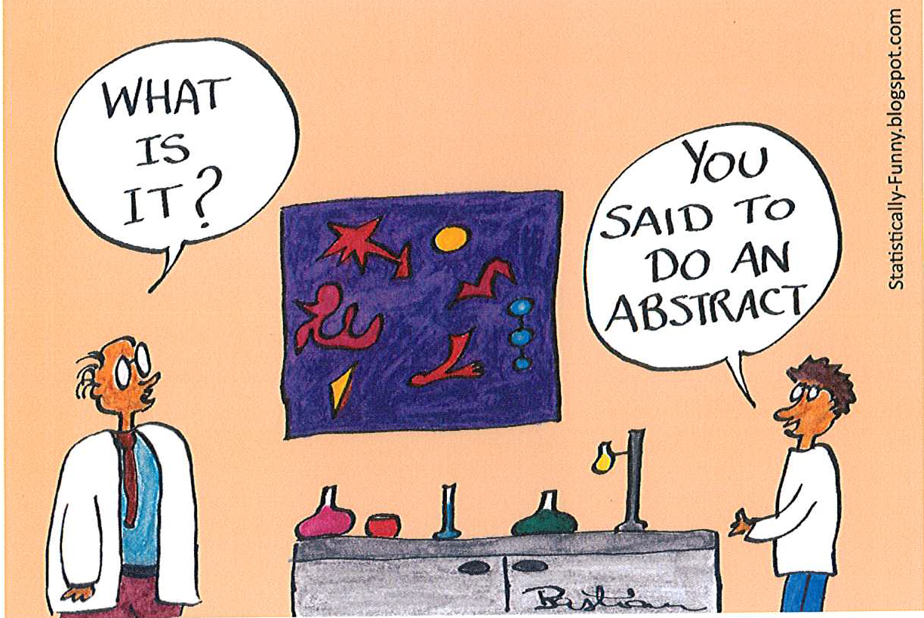

Slide 16
Lunch Break

Slide 17
Visualizing your data effectively
Kim Unger – Fall 2017

Slide 18
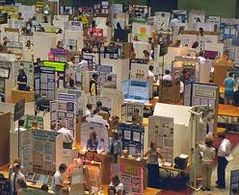
Display & Safety
Updates

Slide 19

Increasing Student Involvement in Science Research

Slide 20
How can we excite and support students to participate in research?
by Mary Anderson, Brevard RSEF
Make if fun!!
Establish a culture/climate for independent research
Share your successes
Get your local community involved
Get your parents involved

Slide 21
Promoting Positive Attitudes
Towards Science Research
Heightening student interest in science and allow for the exploration of personal interest areas
Promoting the cognitive and intellectual development of students
Engaging students in authentic, hands-on experiences through scientific investigation
Bringing attention to scientific experiences in school
Fostering the development of students’ sense of personal capabilities and qualities
Providing the opportunity to recognize and commend scientific accomplishments
Heightening public interest for scientific teaching and learning including the scientific abilities of students
Instilling an appreciation for the relevance of science in daily life
Developing responsibility to serve above yourselves

Slide 22
Student Motivation –
Reasons to do Science Research
Part of rigorous curriculum/culture for learning
Involved in ethical research
Problem solving/critical thinking
Hands-on/authentic
Awards
Scholarships
Trips/Opportunities
Career development
College resume / perseverance; involvement; passion
Building skills – science/engineering/communication
Community service
Competition
Showcase school/district
Personal success/feelings of accomplishment
Connecting with professionals/mentors/judging interviews
Application of real world problem solving
Travel; Fun; memorable experiences

Slide 23
Participant Reflections on
Science Fair Experiences…Jeffrey I. Seeman
Fair participants……..
feel they are “stretched” academically and personally
recommend “choosing a project that interests you”
recognize that their own curiosity and interests can lead to compelling research questions and substantive scientific hypothesis
believe their research can and will have meaningful consequences
feel they are “living” the scientific process – just as professionals do
feel welcomed and encouraged to interact with professional scientists
feel they are EXPERTS on their topics

Slide 24
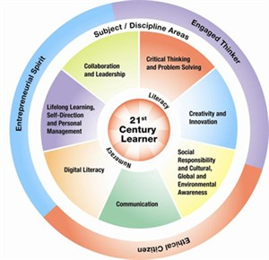

Slide 26


List and describe the function(S) of your RSEF committees
What is the make up of the make up of the committees…teachers, district, community???
OR

Slide 27
List the Operational Expenses
Involved with your RSEF
Facilities/Venues
Supplies
Stipends
Workshops/Meetings
Awards
Hospitality
Travel
Other

Slide 28

Marketing!
What are the sources for your funds?
What are your fundraising activities?

Slide 29
Science Research: Eligibility for
STEM Competitions
“The most important quality for scientists are persistence, integrity, loyalty, having an open mind, being a hard work, courage, resilience, and adaptability.”
Martin Chalfie (Nobel Prize winner in Chemistry, 2008)

Slide 30
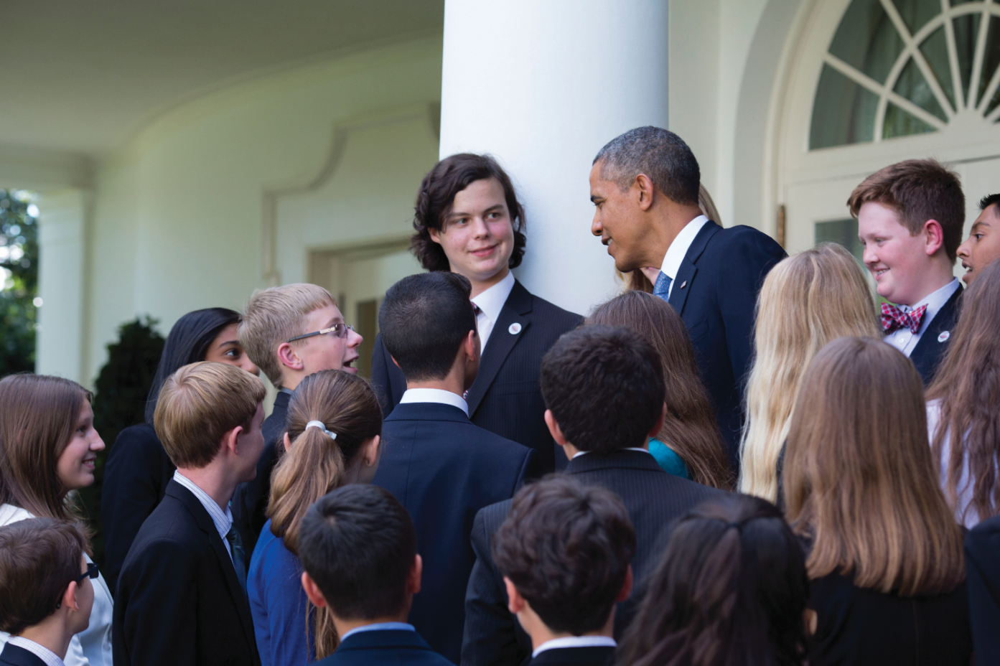

Slide 31
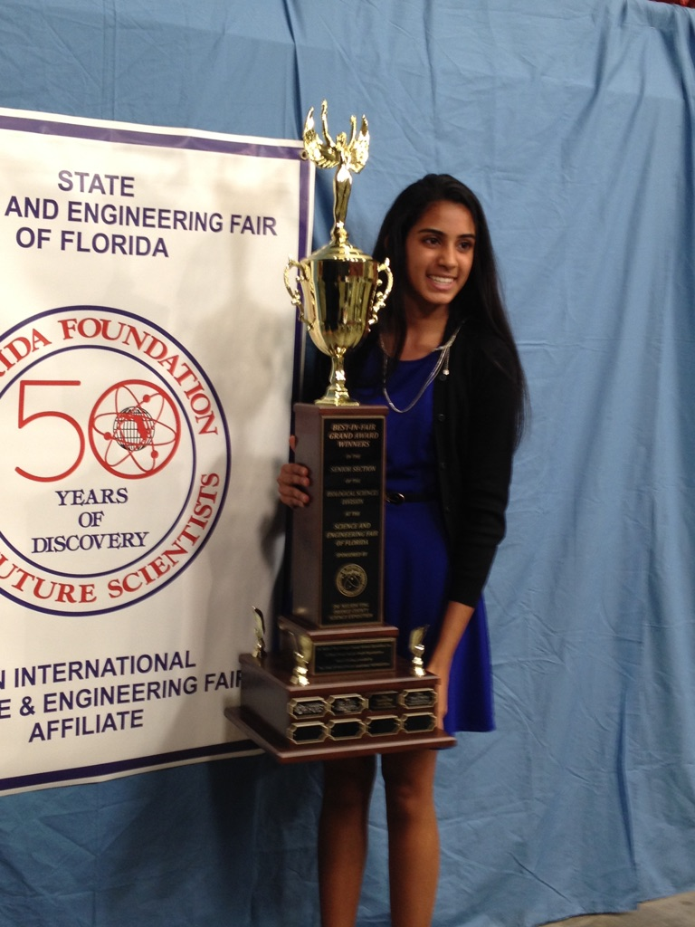

Slide 32
Get Your Local
Community Involved
Colleges/Universities
Businesses
Organizations
Health Industry
Mentors
Newspaper; radio; TV

Slide 33
Get your parents involved
Email parents
Ask for volunteers
Create a database so you can contact them for years to come
Send home pictures of kids working
Have parents come in and speak to kids

Slide 34
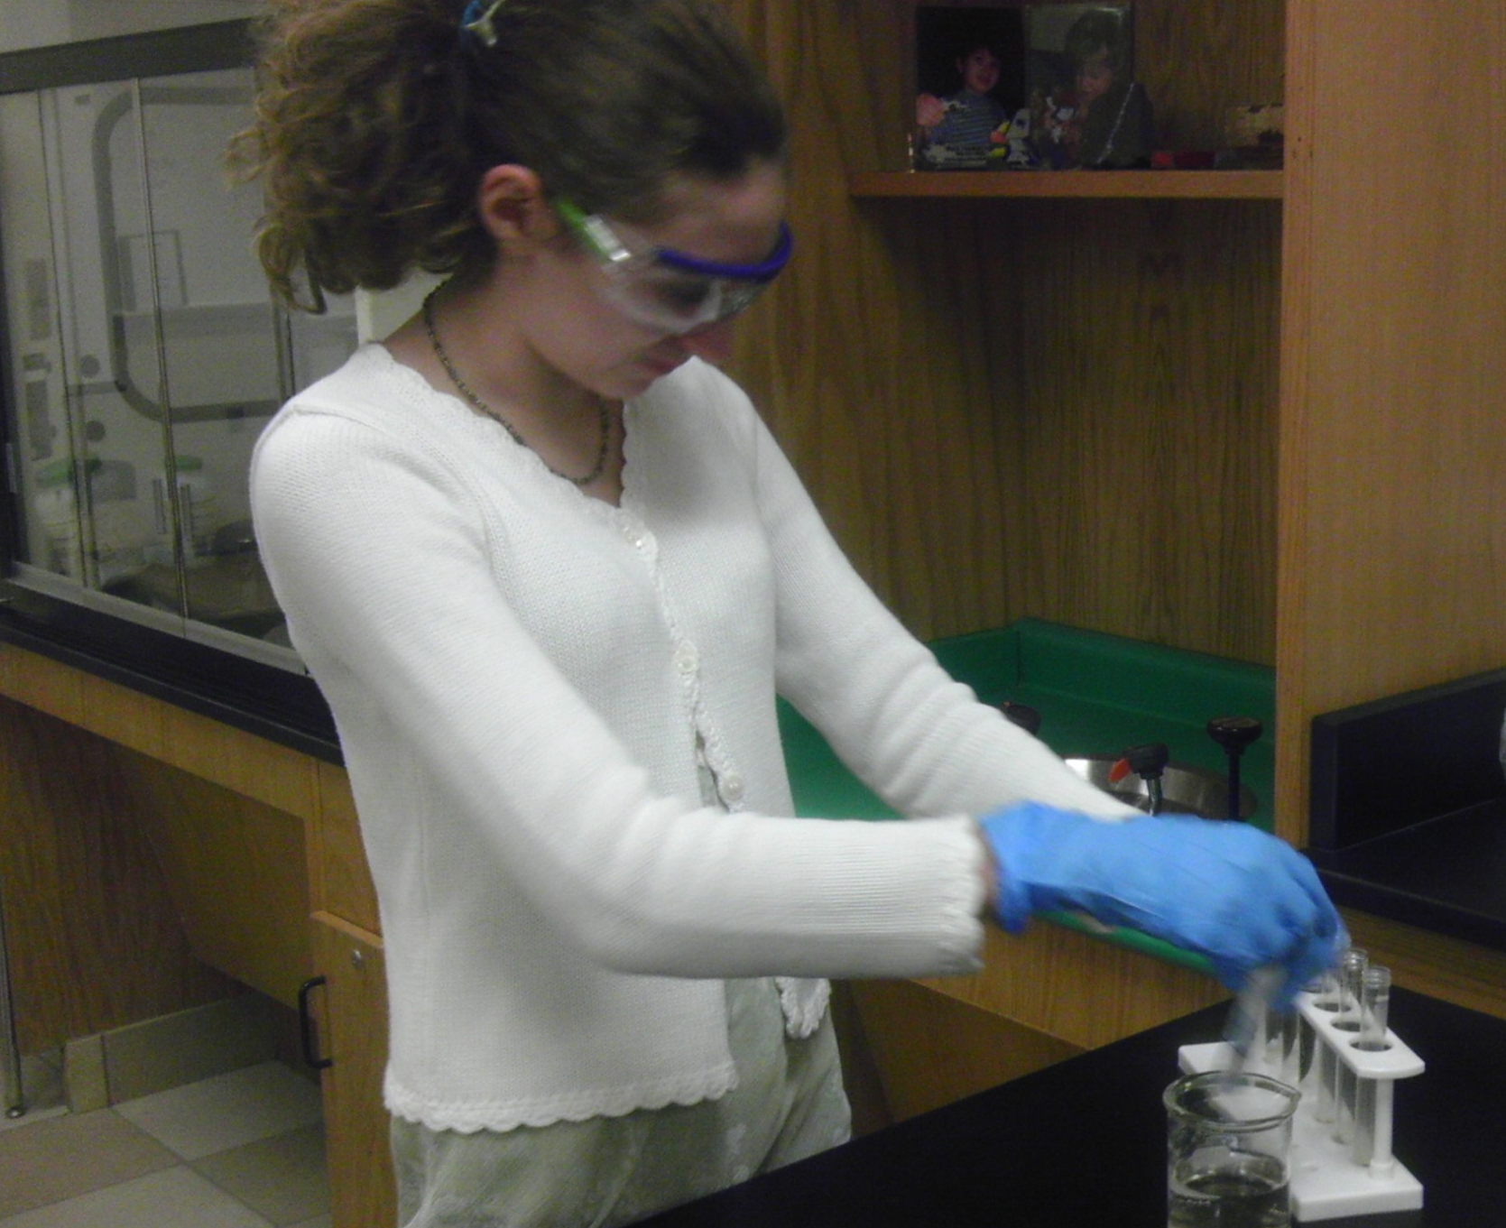
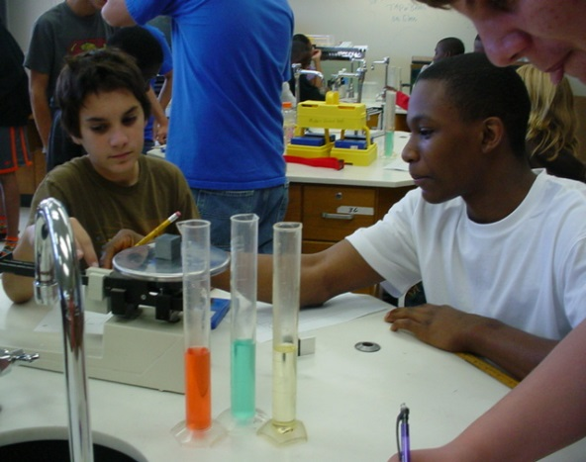
How Can We Empower Educators
To Maximize Authentic
Science Learning ?
By Ginger Davis, District Science Supervisor (Brevard, Retired)
What Does Authentic Science Learning Look Like?
Cognitively Complex Tasks
Learner Engagement
Inquiry

Slide 36
More than 35 years of solid research show that inquiry is the best way for learners to construct meaning in science.

Slide 37




Table Reporting
But…
Who Has Time?

Slide 38
FCAT Science 2.0 2015
Content Focus Report
SC.8.N.1.1 (Experimental Design) = 10.7 %
SC.7.L.17.2 (Energy Transfer; Limiting Factor) = 7.1 %
SC.7.E.6.2 (Human Impact) = 7.1 %
SC.7.E.7.4 (Weather/Climate Differentiation) = 5.35 %
SC.7.9.11.2 (Energy) = 5.35 %

Slide 39
Biology EOC 2015
Content Focus Report
SC.912.N.1.1 (Experimental Design) = 12.5 %
SC.912.L.17.5 (Ecosystems) = 10.25 %
SC.912.L.16.17 (Mitosis/Meiosis) = 7.1 %
SC.912.L.17.20
(Cost/benefits; Human Impact) = 4 %

Slide 40
SC.912.N.1.1
SC.912.N.1.1
Define a science problem and do the following:
• Pose questions about the natural world.
• Conduct systematic observations.
• Review what is known in light of empirical evidence.
• Plan investigations.
• Use tools to gather, analyze, and interpret data.
• Pose answers, explanations, or descriptions of events.
• Generate explanations that describe natural phenomena.
• Use appropriate evidence and reasoning to justify those
explanations to others.
• Communicate results of scientific investigations.
• Evaluate the explanations produced by others.

Slide 41
What Opportunities
Do You See for…
Literacy Standards?
Mathematical Practices?
STEM?
Engineering Design Practices?
Other?

Slide 42
Brevard’s Teacher Evaluation
Rubric Elements:
Promotes a student-centered learning environment
Manages time, space, and resources
Creates a positive environment of respect and rapport
Maintains a climate of inquiry
Employs higher order questions
Differentiates instruction
Uses varied instructional strategies and resources

Slide 43
What Does Science Research
Support Look Like?

Slide 44
What types of support are needed?
In school classes (and before/after school)
Annually Updated Guide
District-wide teacher, parent and student briefings
Superintendent & Senior Staff Attend Science Fair & Awards
School Board presentations and recognitions
Teacher Stipends, Fair Director Stipends, Sub Days
Foundation “Matching Funds” Program
Course rubrics in lieu of Final Exams (20% of grade)
Priority status and considerations (Research is valued.)

Slide 45
Rules & Responsibilities of the Student
The student researcher is responsible for
All aspects of the research project
Enlisting the aid of any required supervisory adults
Obtaining necessary approvals for the research (SRC, IRB)
Performing the experimentation, engineering,
analysis, etc.

Slide 46
Rules & Responsibilities of the Adult Sponsor
The Adult Sponsor (teacher, parent, professor) …
Is responsible for working with the student to evaluate possible risks
Should be familiar with the regulations that govern the research
Is responsible for ensuring the student’s research is eligible for entry into affiliated competitions
Must review the Student Checklist (1A) and Research Plan/Project Summary to ensure
  Experimentation is within the SSEF of Florida and Intel ISEF local, state and federal laws
  Necessary forms are completed by other required adults
  The Qualified Scientists, if required, meets the requirements

Slide 47
Rules & Responsibilities of the Qualified Scientist
The Qualified Scientist
should have earned a doctoral/professional degree in the scientific discipline that relates to the student’s area of research
MAY be an individual with extensive expertise in the student’s area of research
Must be thoroughly familiar with local, state, federal and Pre-college research regulations that govern the area of research

Slide 48
Rules & Responsibilities of the Designated Supervisor
The Designated Supervisor
the adult who is DIRECTLY responsible for overseeing student experimentation
need not have an advanced degree, but must be thoroughly familiar with project
must be trained in the student’s area of research
may be the Adult Supervisor
If working with vertebrates, must be knowledgeable about humane care and handling of animals

Slide 49
Responsibilities of the
Scientific Review Committee(SRC
Scientific Review Committee (SRC) examines projects for..
Evidence of literature search
Evidence of proper supervision
Use of accepted and appropriate research techniques
Completed forms, signatures, and dates (appropriate pre-approval if required)
Evidence of humane treatment of animals
Compliance with rules and laws
Documentation of substantial expansion for a CONTINUATION project
Compliance with ethics statement

Slide 50


Affiliated Competitions
Local/School Fairs
Regional Science Fairs (37 in Florida – all Districts)
State Science Fair www.ssefflorida.com
Intel ISEF
https://student.societyforscience.org/intel-isef
Broadcom MASTERS
https://student.societyforscience.org/broadcom-masters
Regeneron STS
https://student.societyforscience.org/regeneron-sts

Slide 51
Research Categories
FULL Category Name
Animal Sciences
Behavioral & Social Sciences
Biomedical & Health Sciences
Cellular/ Molecular Biology & Biochemistry
Chemistry
Earth & Environmental Sciences
Engineering
Environmental Engineering
Intelligent Machines, Robotics & Systems Software
Mathematics & Computational Sciences
Microbiology
Physics & Astronomy
Plant Sciences

Slide 52
Other Competitions
Orlando Science Center Science Challenge
Dr. Nelson Ying Science Competition
Florida Junior Academy of Science
I-SWEEPE
Siemens Competition in Math, Science & Technology
Junior Science, Engineering and Humanities Symposium – JSEHS
Google Science Fair
US National BioGENEius Challenge
Stockholm Junior Water Prize

Slide 53
The Archimedes Initiative; www.archimedesinitiative.org
Free, online video archive
Students addressing their peers
Recorded at county, state science fairs and ISEF
17 themed videos of high school students information, insight, inspiration, and personal experiences
49 Project video series – individuals discuss research
19 Topic Video series - several students discuss the same topic

Slide 54

#FloridaSSEF

