Slide 1
INTEL INTERNATIONAL SCIENCE AND ENGINEERING FAIR
2016 Rules and Guidelines

Slide 2
Adult Roles and Responsibilities
Adult Sponsor
Qualified Scientist
Designated Supervisor
Institutional Review Board (IRB)
Scientific Review Committee (SRC)

Slide 3
Adult Sponsor
Oversees project to make sure that student…
is informed of ISEF Rules and Guidelines
is aware of risks associated with project
is aware of forms required for project
is provided proper supervision during experimentation
if required, submits project to IRB or SRC
Teacher usually serves as Adult Sponsor

Slide 4
Qualified Scientist
Required for some projects
Completes Form 2 – QS Form
Should have a doctoral/professional degree related to student research
Or
Have applicable experience and expertise with
review and approval by the SRC

Slide 5
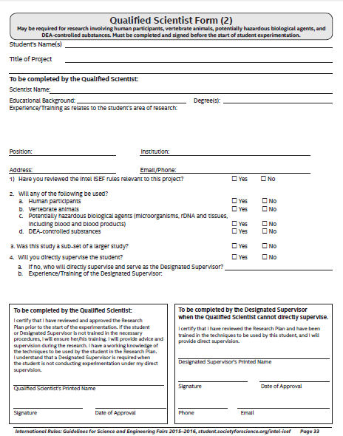

Slide 6
Designated Supervisor
Supervises projects involving hazardous chemicals, activities or devices
Supervises projects requiring a Qualified Scientist when the Qualified Scientist cannot directly supervise the student
For vertebrate animal projects, an Animal Care Supervisor is required

Slide 7
Institutional Review Board (IRB)
Reviews human participant studies
Membership must include:
an educator
a school administrator
someone knowledgeable about evaluating physical and/or psychological risk: MD, PA, RN, psychologist, licensed social worker or licensed clinical professional counselor

Slide 8
Scientific Review Committee (SRC)
Reviews some projects before experimentation
Reviews all projects just prior to competition
Membership must include:
a biomedical scientist with an earned doctoral degree
an educator
one other member

Slide 9
Combined IRB/SRC
Membership must include:
a biomedical scientist with an earned doctoral degree
a school administrator
an educator
someone knowledgeable about evaluating physical and/or psychological risk: MD, PA, RN, psychologist, licensed social worker or licensed clinical professional counselor

Slide 10
Forms Required for all Projects

Slide 11
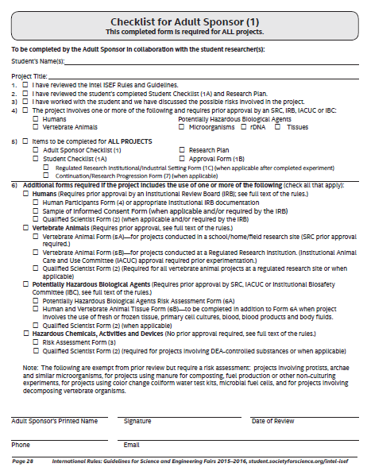

Slide 12
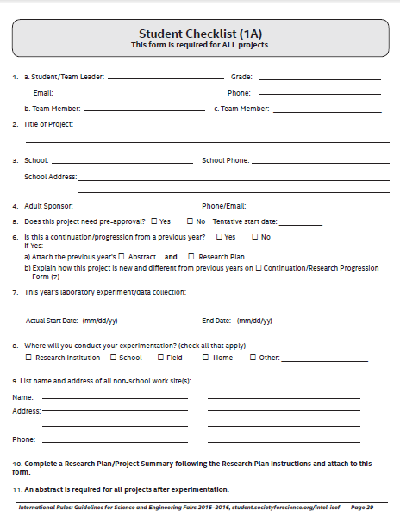

Slide 13
Research Plan/Project Summary
Required for all projects
Should incorporate all of the relevant topics listed in the Instructions
Should summarize what was actually done in the project

Slide 14
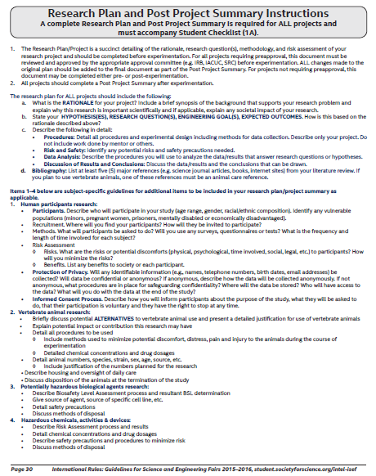

Slide 15
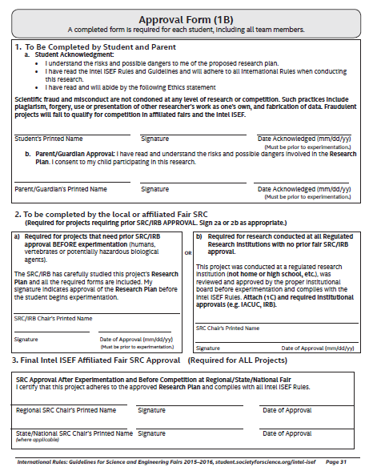

Slide 16
Studies conducted at a research institution, industrial setting or any work site other than home, school or field require Form 1C

Slide 17
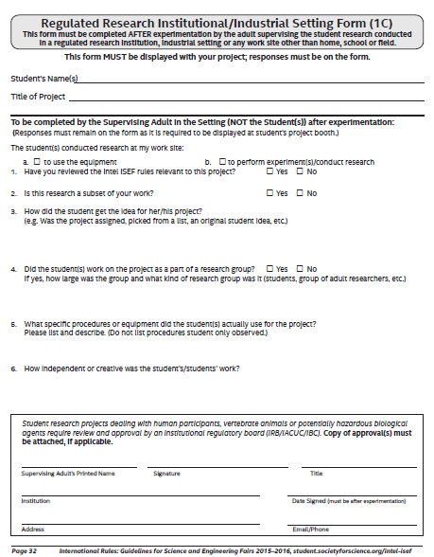

Slide 18
Continuation/Research Progression Studies
Current project based on prior research in the same field of study
Longitudinal studies are permitted
Multi-year study
Studies time-based change
Require Form 7

Slide 19
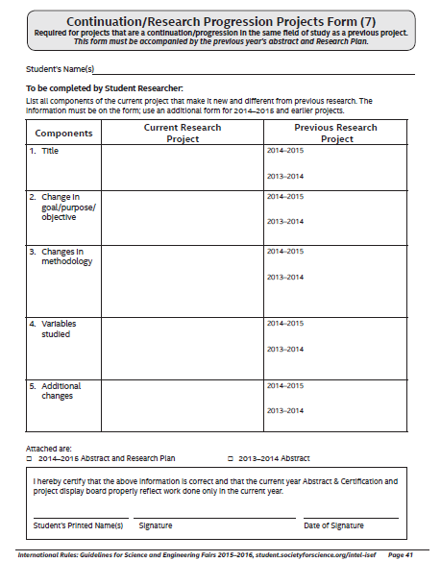

Slide 20
Human Participants

Slide 21
What are Human Participant Studies?
Human participant studies involve living individuals where there is
Intervention or interaction with participants
and/or
Collection of identifiable private information

Slide 22
Exempt studies that do not require IRB review or human participant forms
Testing of a student-designed invention or prototype
Student researcher is the only one doing the testing
No health hazards
No personal data collected
Feedback directly related to product
Studies using pre-existing, publicly available human data

Slide 23
Additional Exempt Studies
Behavioral observations in unrestricted public settings
No interaction
No manipulation of environment
No recording of any personal identifiers
Studies using certified de-identified/ anonymous data

Slide 24
Human Participants Research
The IRB must review and approve the research plan before experimentation begins
Research participants 18 years of age or older must give informed consent
Research participants under 18 must give assent and their parents may be required to give written permission

Slide 25
Human Participants Research, cont’d
The IRB evaluates the project and determines
Risk level
Requirement for Qualified Scientist and/or Designated Supervisor
Requirement for written informed consent/assent/parental permission

Slide 26
Risk Evaluation
No more than minimal risk
Anticipated harm and discomfort not
greater than encountered in daily life
More than minimal risk
Anticipated harm or discomfort is
greater than encountered in daily life
More than minimal risk studies should require written consent/assent and parental permission. Final determination for this requirement made by the IRB

Slide 27
Types of Risk
Physical risks
Exercise
Ingestion, tasting, smelling, application of substances
Exposure to potentially hazardous material
Psychological risks
Invasion of privacy
Participant is a member of an at-risk group

Slide 28
Expedited Review
IRB may elect to do an expedited (one member) review
Can only be used for projects where
Human participants test the functionality of a student-designed invention or prototype with no health of safety hazards and no personal data is collected
The student researcher is the only subject of the research that involves no more than minimal risk

Slide 29
IRB Decisions are Documented on Form 4

Slide 30
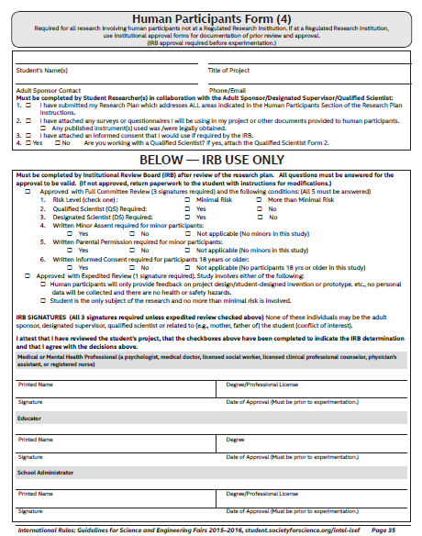

Slide 31
If IRB determines that written informed consent/assent or parental permission is required, documentation is obtained on an “informed consent” document

Slide 32
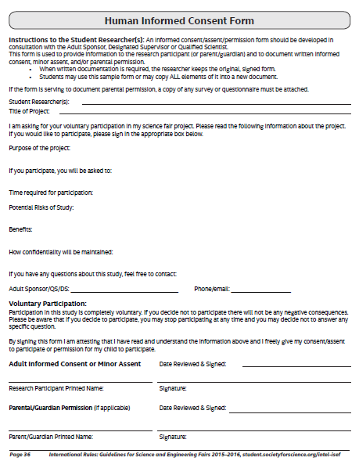

Slide 33
Vertebrate Animals

Slide 34
What is a Vertebrate Animal?
Live, nonhuman vertebrate mammalian embryos or fetuses
Bird and reptile eggs within 3 days of hatching
All other nonhuman vertebrates (including fish) at hatching or birth
Tadpoles
Zebrafish embryos 7 days (168 hours)
post fertilization

Slide 35
Prohibited Studies
Induced toxicity studies involving known toxic substances that cause pain, distress or death
Behavioral experiments with
Conditioning using aversive stimuli
Mother/infant separation
Induced/learned helplessness
Studies of pain
Predator/vertebrate prey experiments

Slide 36
No vertebrate animal deaths due to the experimental procedures are permitted
Studies designed or anticipated to cause vertebrate animal death are prohibited.
Any deaths must be investigated by a qualified individual
If death was the result of experimental procedure the study must be terminated and the study will not qualify for competition.

Slide 37
SRC Exemptions for Behavioral Observations of Animals
There is no interaction with the animals
and
There is no manipulation of the environment
and
All federal or state fish, game and wildlife regulations are followed

Slide 38
Research Sites
School/Home/Field
Regulated Research Institution (must have an IACUC review and approval process)
Universities
Government research agencies
Private research laboratories

Slide 39
Vertebrate Animal Studies Conducted at School/Home/Field may Include
Studies of animals in their natural environment
Studies of animals in zoological parks
Studies of livestock that incorporate standard agricultural practices
Studies of fish that incorporate standard aquaculture practices

Slide 40
Requirements for Studies at School/Home/Field
Agricultural, behavioral, observational or supplemental nutritional studies
and
Non-invasive and non-intrusive with no negative effect on animal’s health or
well-being
and
Require SRC pre-review and approval

Slide 41
Requirements for Studies at School/Home/Field (cont’d.)
SRC must determine the level of supervision appropriate for the study:
Designated supervisor
Veterinarian
Qualified scientist
Form 5A required

Slide 42
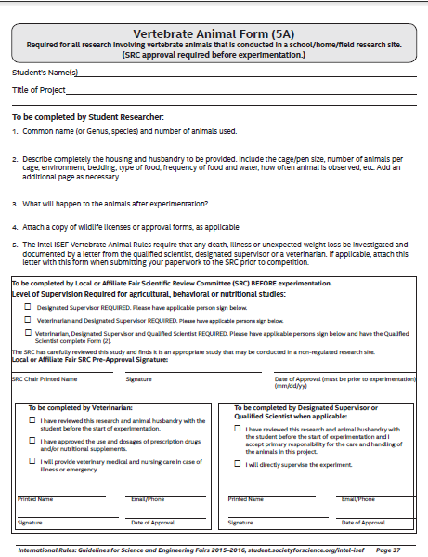

Slide 43
Requirements for Studies at Regulated Research Institutions
Must be approved by IACUC (Institutional Animal Care and Use Committee)
Local SRC should review project before experimentation
Experimentation must follow ISEF rules
Qualified Scientist completes Form 5B
which includes documentation of IACUC
approval

Slide 44
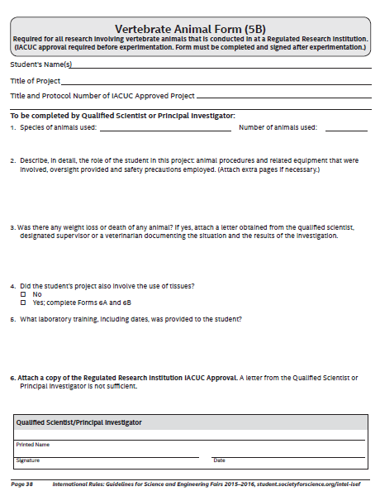

Slide 45
Potentially Hazardous Biological Agents

Slide 46
Potentially Hazardous Biological Agents
Microorganisms (including bacteria, viruses, fungi, etc.)
Recombinant DNA
Human or animal fresh/frozen tissues, blood or body fluids

Slide 47
All studies involving potentially hazardous biological agents
Studies must have prior approval by SRC/IACUC/IBC
Most studies are prohibited in a home environment
Studies intended to genetically engineer bacteria with multiple antibiotic resistance are prohibited
Lab studies utilizing MRSA, VRE and KPC must be conducted in a Regulated Research Institution under documented IBC review and approval. Students are prohibited from culturing CRE.

Slide 48
Risk Assessment
Required of all PHBA projects
Defines potential level of harm, injury or disease to plants, animals or humans
Involves
Assignment of biological agent to risk group
Determination of level of biological containment
Assessment of expertise of adult(s)
Assignment of final biosafety level

Slide 49
Risk Assessment, cont’d
BSL 1 studies can usually be conducted in a high school or college teaching laboratory.
BSL 2 studies are usually conducted in a regulated research institution
BSL 3 and BSL 4 studies are prohibited for ISEF projects
Form 6A (Potentially Hazardous Biological Agents form) required for most projects involving microorganisms, and for all projects involving rDNA and fresh human and vertebrate animal tissues

Slide 50
Resources to find BSL Level
American Biological Safety Association website: www.absa.org
American Type Culture Collection website: www.atcc.org

Slide 51
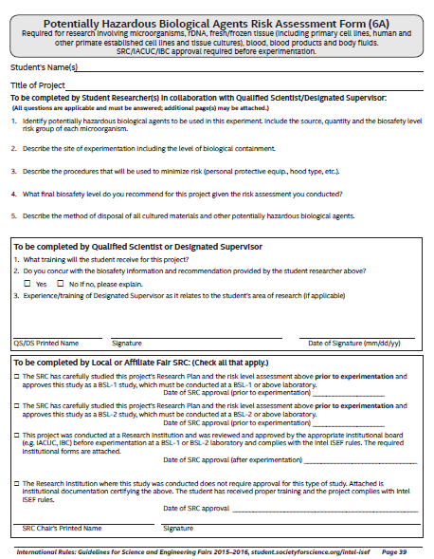

Slide 52
Studies Exempt from Prior SRC Review and Do Not Require PHBA Forms
Studies using baker’s and brewer’s yeast (except rDNA studies)
Studies using Lactobacillus, nitrogen-fixing bacteria, B. thuringinensis, oil-eating bacteria, and algae-eating bacteria in natural environment. Not exempt if cultured in a petri dish environment
Studies of mold growth on food items if experiment terminated at first sign of mold
Studies involving water or soil not concentrated in media conducive to growth
Studies of mushrooms and slime mold
Studies with E.coli K-12 done at school, except in rDNA studies

Slide 53
Studies Exempt from Prior SRC Review that Require Form 3
Studies involving protists, archae and similar microorganisms
Research using manure for composting, fuel production, or other non-culturing experiments
Studies using commercially available color change coliform water test kits
Studies involving decomposition of vertebrate organisms (forensic studies)
Studies with microbial fuel cells

Slide 54
Studies Involving Unknown Microorganisms
BSL 1 if
Organisms cultured in plastic petri dish
Culture dish remains sealed throughout experiment
Culture dish disposed of in appropriate manner
BSL 2 if
petri dish is opened

Slide 55
rDNA Technologies
Experiments with BSL 1 organisms can be done in BSL 1 lab with a Qualified Scientist or trained Designated Supervisor
Experiments with BSL 2 organisms must be done in a regulated research institution with a Qualified Scientist

Slide 56
Tissues
If animal is euthanized solely for student project – vertebrate animal study which requires IACUC approval
If animal is euthanized for a purpose other than student project – tissue study
Classification as BSL 1 or 2 based on source of tissue and possibility of containing infectious agents
All studies with human or wild animal blood are BSL 2. Studies with domestic animal blood are BSL 1.
Studies with human body fluids which can be associated with a person must have IRB approval

Slide 57
Exempt as PHBA Tissues
Plant tissues
Plant and non-primate established cell and tissue cultures
Fresh or frozen meat, meat by-products, pasteurized milk, eggs – from grocery stores, restaurants, packing houses
Hair, hooves, nails and feathers
Sterilized teeth
Fossilized tissue/archeological specimens
Prepared fixed tissue slides

Slide 58
Form 6B
Required for all projects using
Fresh/frozen tissue
Primary cell cultures
Human and other primate established cell lines and tissue cultures
Blood and blood products
Body fluids

Slide 59
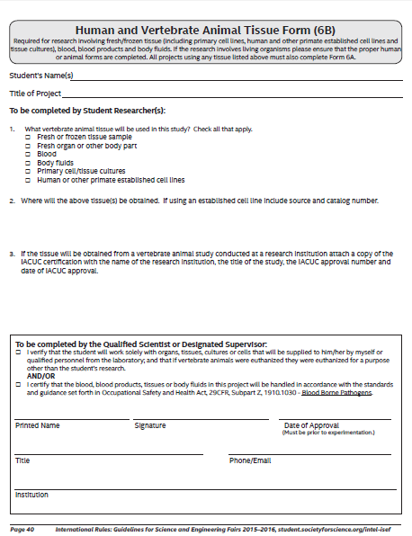

Slide 60
Hazardous Chemicals, Activities, or Devices

Slide 61
Hazardous Chemicals, Activities or Devices
Chemicals
Equipment
DEA-Controlled Substances
Prescription Drugs
Alcohol and Tobacco
Firearms and Explosives
Radiation

Slide 62
General Rules
Studies do not require prior SRC review and approval
All studies require a Risk Assessment documented on Form 3
DEA - controlled substances require a Qualified Scientist
All other studies require a Designated Supervisor

Slide 63
DEA-Controlled Substances
Consult DEA list of controlled substances
All studies require Qualified Scientist
Controlled substances on Schedule 1 require DEA protocol review
Firearms and Explosives
Must adhere to local training and certification requirements

Slide 64
Alcohol and Tobacco
Students must adhere to U.S. regulations as well as local and country laws
Production of wine or beer by adults is allowable. Parents must directly supervise any student research involving legal home production
Alcohol distillation for fuel production or other non consumable products can be conducted at school with TTB permit obtained by school officials

Slide 65
Prescription Drugs
Cannot be administered to human subjects
Animal administration must follow ISEF vertebrate animal guidelines
Hazardous Chemicals
Refer to MSDS Sheets for safety and disposal information
Hazardous Devices
Involve level of risk beyond that encountered in student’s everyday life
Follow handling guidelines

Slide 66
Radiation
Studies using non-ionizing radiation and studies of ionizing radiation using voltage < 10 kvolts require a documented risk assessment on Form 3
Studies of ionizing radiation using voltage between 10 and 25 kvolts must be preapproved by the SRC and have a documented risk assessment
Studies of ionizing radiation using voltage exceeding 25 kvolts must be conducted in a site with a Licensed Radiation Program and preapproved by the institution

Slide 67
Form 3
Required for all projects involving
DEA-Controlled Substances
Prescription Drugs
Alcohol and Tobacco
Hazardous Chemicals
Hazardous Devices
Hazardous Activities
Radiation

Slide 68
